Slide 1

Environment and Resource Economics
Lecture - 1
Seungho Jeon

Slide 2

Table of Contents
1. Teaching Demonstration
03
Conceptual Foundation
Real World Application
Assignment & Food for thoughts
04
12
17
2. Research Achievement
20
Integrated Assessment Model
Empirical and Applied Research
26
33
3. Teaching Experience & Plan
35

Slide 3
Introduction

Slide 4
Excludability and Rivalry
Is the good excludable? | : Can people be prevented from using the good?
Is the good rival in consumption? | : Does one person’s use of the good reduce another person’s ability to use it?
Rival in consumption?
Private goods Ice-cream cones Clothing | Club goods OTT (Netflix) Uncongested toll roads
Common resources Fish in the ocean The environment | Public goods National defense Tornado siren
Excludable?
한밭대학교 2025학년도 제1차 전임교원 공개채용 | 경제학과 자원·환경·에너지 분야 | 전 승 호

Slide 6

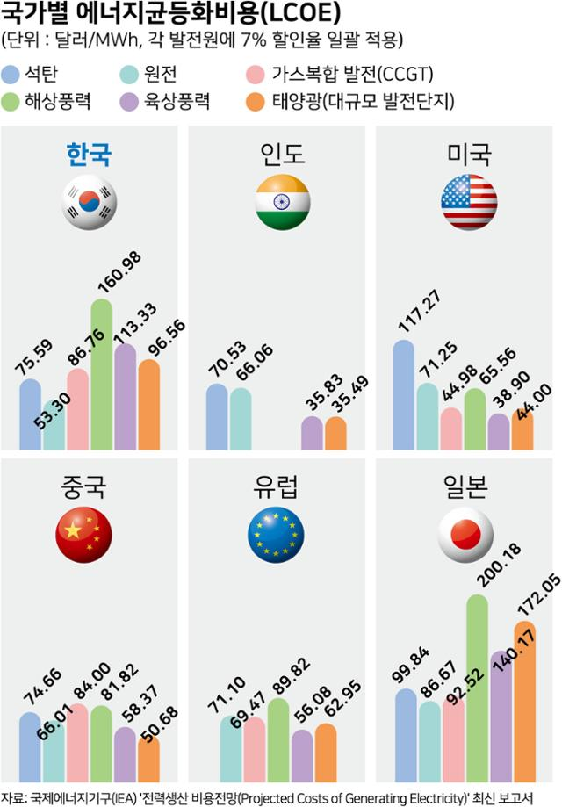








Introduction of the Topic
국가별 에너지 균등화 비용 (LCOE)
(단위: 달러/MWh, 각 발전원에 7% 할인율 일괄 적용)
석탄
해상풍력
원전
육상풍력
가스복합 발전(CCGT)
태양광(대규모 발전단지)
Today’s Learning objectives
Understand the concept and formula of LCOE
Recognize its limitations in real-world decisions
Estimate PV (Photovoltaic) generation using two methods
Apply LCOE to assess a PV system on campus
한국
인도
미국
육
상
풍
력
해
상
풍
력
태
양
광
석
탄
원
전
가
스
중국
유럽
일본
자료: 국제에너지기구(IEA) ‘전력생산 비용전망(Projected Costs of Generating Electrivity) 최신 보고서
Source: 한국일보. “한국 재생에너지 단가 비싸...태양광·해상풍력 미국의 두배 넘어 [갈 길 먼 RE100③]”. 2023.10.21., https://www.hankookilbo.com/News/Read/A2023101611280003604
한밭대학교 2025학년도 제1차 전임교원 공개채용 | 경제학과 자원·환경·에너지 분야 | 전 승 호

Slide 7






The Three Key Costs in Power Generation
Lifetime
Construction
Operation
t=0
t=T
COAL
Nuclear
Solar
Capital Cost
The cost to build the power plant
before it starts operating
Plant construction,
Equipment and installation,
etc.
O&M Cost (Operation & Management)
The cost to operate and maintain
the plant during its lifetime
Labor cost,
Repair cost,
etc.
Fuel Cost
The cost to purchase fuel needed to generate electricity
Coal, Gas,
Oil, Nuclear,
etc.
한밭대학교 2025학년도 제1차 전임교원 공개채용 | 경제학과 자원·환경·에너지 분야 | 전 승 호

Slide 8
Comparing Electricity Generation Options
Different cost structure of electricity sources
Fuel | Nuclear | Coal | Gas | Solar PV
Capital cost | High | Medium | Low | Medium - High
O&M cost | High | Medium | Medium | Low
Fuel cost | Low | Medium | High | Zero
Lifetime | 40-60 yr | 30-40 yr | 25-30 yr | 20-30 yr
Emissions | Low | High | Medium - High | Zero
How can we compare different electricity sources?
한밭대학교 2025학년도 제1차 전임교원 공개채용 | 경제학과 자원·환경·에너지 분야 | 전 승 호

Slide 9
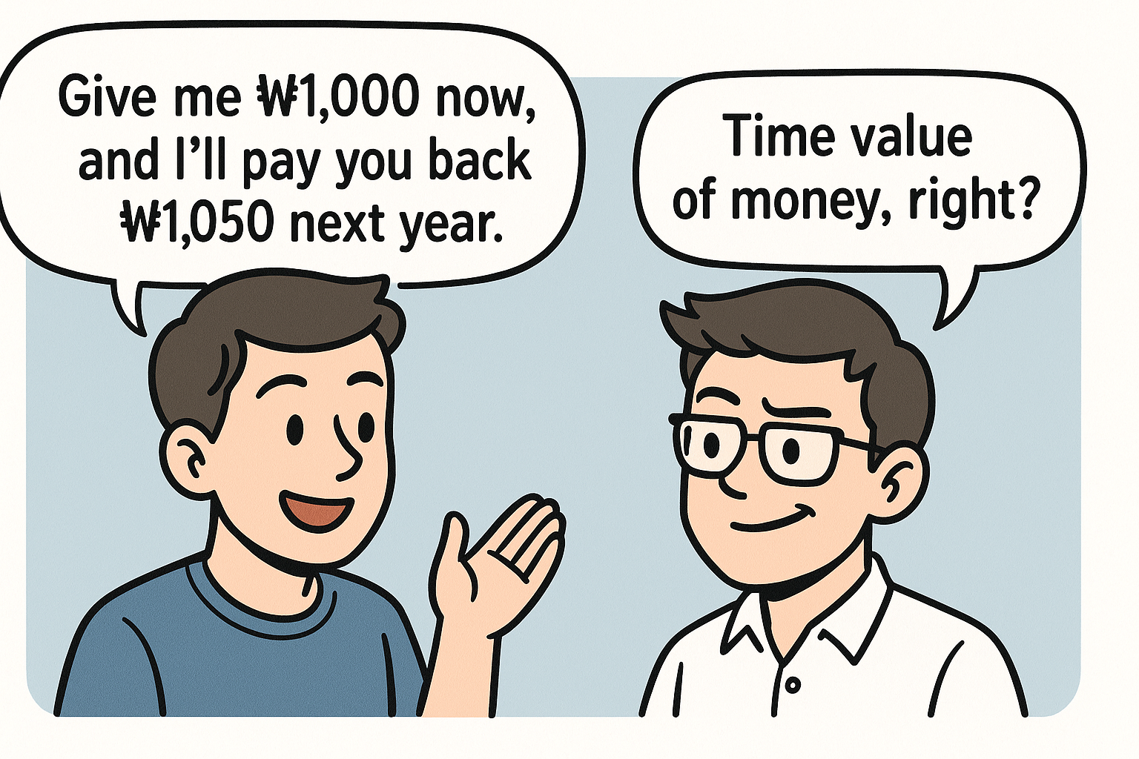
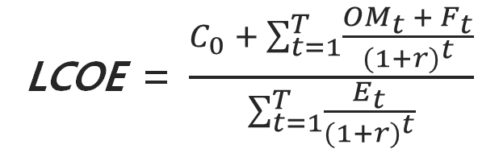
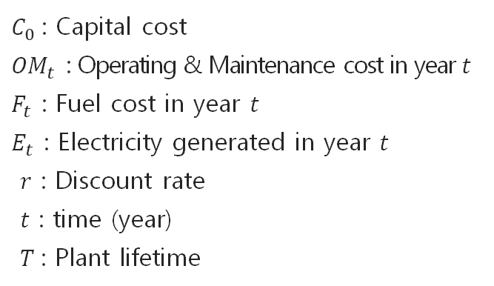
What is LCOE?
LCOE (Levelized Cost of Electricity) :
Average cost to generate 1kWh* of electricity
over the lifetime of a power plant, expressed in present value terms
Why do we discount future values?
Money today is more valuable than money in the future
Because we can use it now, invest it, or buy something right away
In LCOE, we discount future costs and electricity to compare fairly in today’s value.
LCOE = $\frac{C_{0} + \sum_{t=1}^{T}{\frac{{OM}_{t} + F_{t}}{{(1+r)}^{t}}}}{\sum_{t=1}^{T}{\frac{E_{t}}{{(1+r)}^{t}}}}$
$C_{0}$: Capital cost
${OM}_{t}$ : Operating & Maintenance cost in year $t$
$F_{t}$ : Fuel cost in year $t$
$E_{t}$ : Electricity generated in year $t$
$r$ : Discount rate
$t$ : time (year)
$T$: Plant lifetime
* kWh: A unit for measuring the amount of electrical energy
한밭대학교 2025학년도 제1차 전임교원 공개채용 | 경제학과 자원·환경·에너지 분야 | 전 승 호
Notes:
투자비, O&M, 발전원별 특징 설명
LCOE 개념 설명

Slide 10
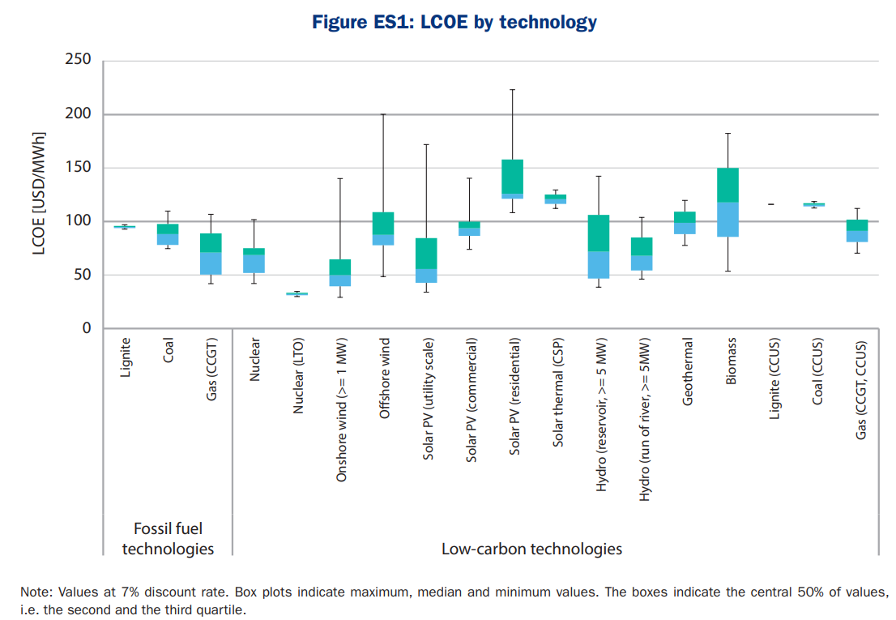
LCOE by Technology
243 plants in 24 countries
4
3
2
1
LCOE ranking
1. Nuclear
2. Gas
3. Coal
4. Solar PV
The LCOE of PV is relatively high
Source: IEA. (2020). Projected Costs of Generating Electricity 2020 Edition. IEA, France.
한밭대학교 2025학년도 제1차 전임교원 공개채용 | 경제학과 자원·환경·에너지 분야 | 전 승 호
Notes:
전통 발전 기술보다 PV의 LCOE가 높음.
https://iea.blob.core.windows.net/assets/ae17da3d-e8a5-4163-a3ec-2e6fb0b5677d/Projected-Costs-of-Generating-Electricity-2020.pdf
https://www.lazard.com/media/xemfey0k/lazards-lcoeplus-june-2024-_vf.pdf

Slide 11
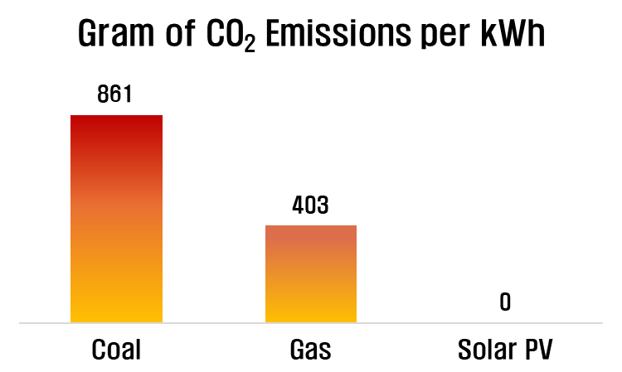
A Limit of LCOE: Is cost everything?
LCOE only reflects monetary costs.
It does not account for environmental impacts, health effects and more.
Some technologies offer hidden value not captured in LCOE.
Why is PV valuable beyond cost?
Solar PV emits no greenhouse gases during operation.
While its LCOE may seem higher, it brings a hidden value: zero emissions.
In economics, this is called a positive externality.
한밭대학교 2025학년도 제1차 전임교원 공개채용 | 경제학과 자원·환경·에너지 분야 | 전 승 호

Slide 12
Teaching Demonstration: Real-World Application

Slide 13
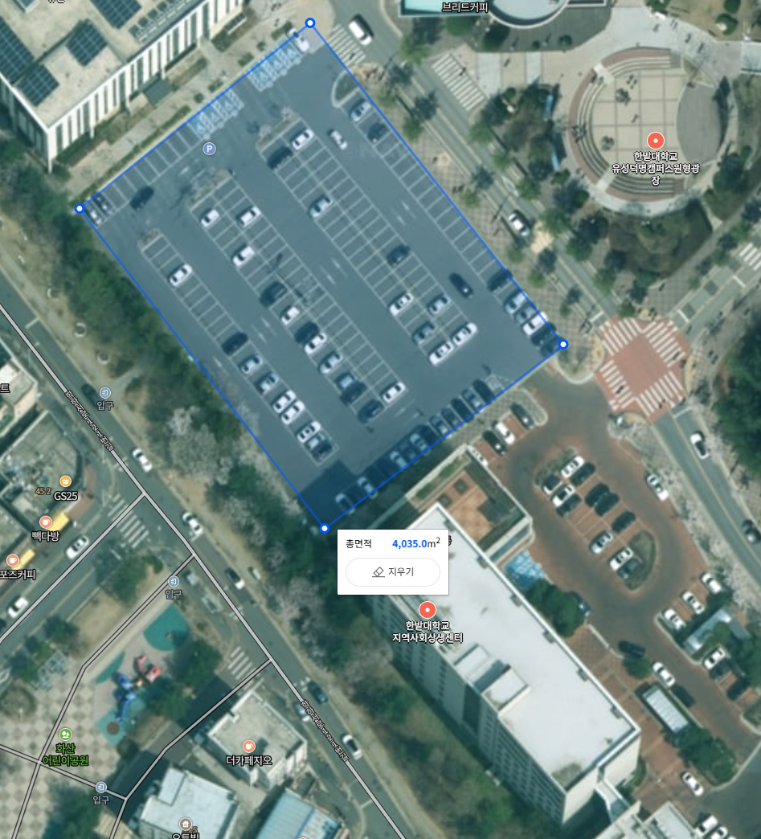
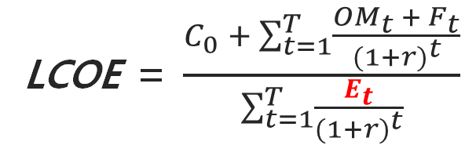
Estimation of electricity generation
How much electricity would be generated annually
if we install solar PV panels on the parking lot
next to the Department of Economics at Hanbat University?
LCOE = $\frac{C_{0} + \sum_{t=1}^{T}{\frac{{OM}_{t} + F_{t}}{{(1+r)}^{t}}}}{\sum_{t=1}^{T}{\frac{E_{t}}{{(1+r)}^{t}}}}$
How can we estimate it?
국립한밭대학교 2025학년도 제1차 전임교원 공개채용 | 경제학과 자원·환경·에너지 분야 | 전 승 호

Slide 14

Key concepts for Estimating PV Electricity Generation
The Principle of Solar PV Generation
Solar PV systems generate electricity using the photovoltaic effect, which converts sunlight into direct current (DC)
However, since most appliances and the power grid use alternating current (AC), a DC to AC conversion is needed
The amount of sunlight available at a location is measured as GHI* which is a key input for estimating electricity generation
* GHI: Global Horizontal Irradiance
Sunlight
PV System
η = 0.2
Grid
PV
20 unit of
electricity
100 unit of
solar energy
DC/AC
Inverter
There are two methods for
estimating solar PV electricity generation
Irradiance-based
Capacity-based
국립한밭대학교 2025학년도 제1차 전임교원 공개채용 | 경제학과 자원·환경·에너지 분야 | 전 승 호

Slide 15
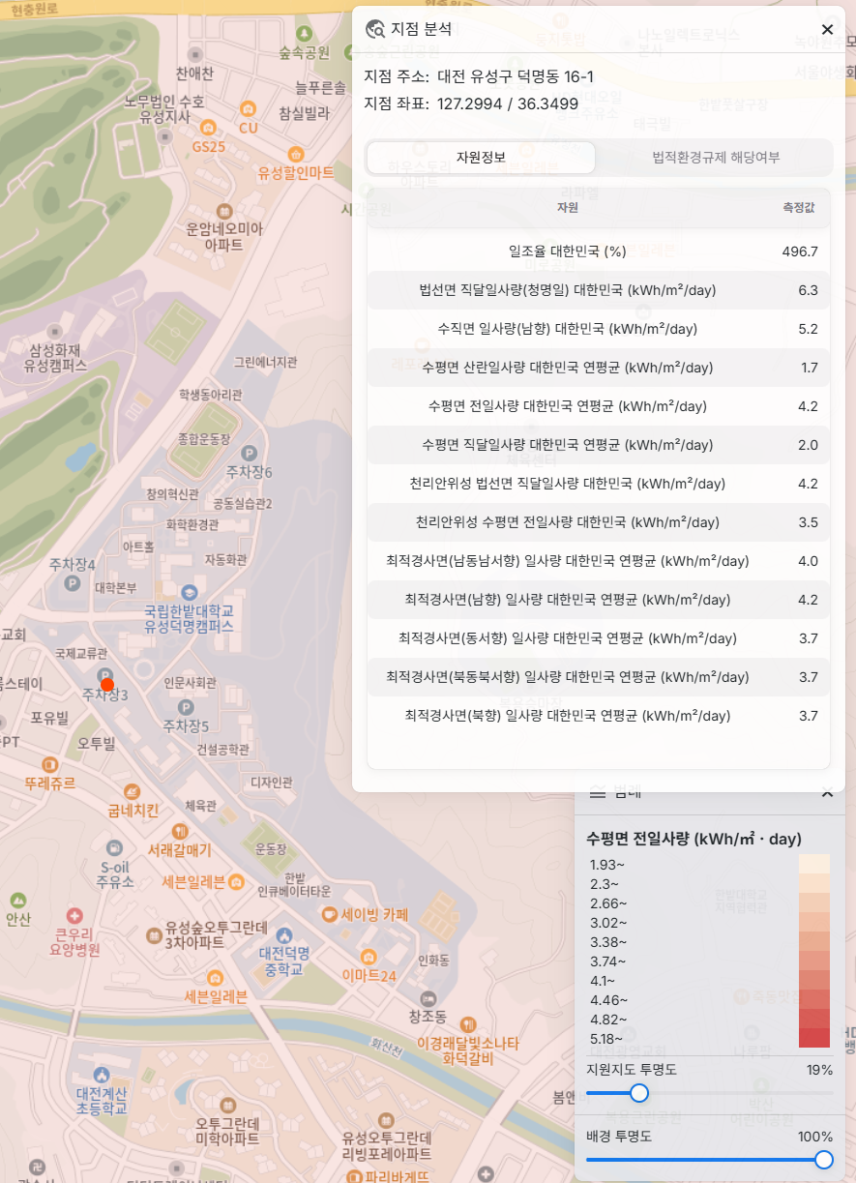
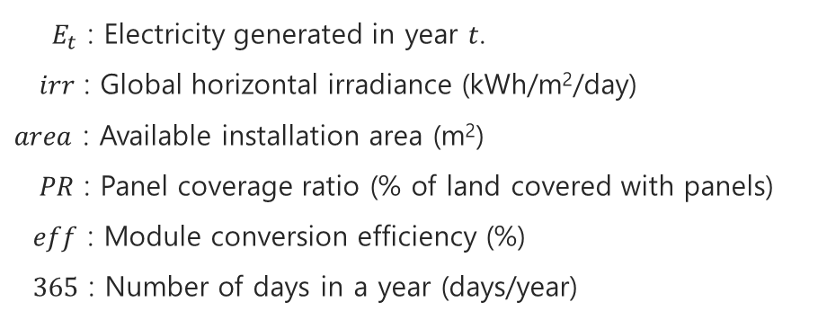

Estimation of PV generation: Irradiance-based
Irradiance-based Estimation
Solar irradiance falls on the available installation area, a portion of which is covered with solar PV modules
The modules convert sunlight into electricity based on their efficiency
This process, repeated over 365 days, gives us the annual electricity generation
$E_{t}$ = $irr×area×PR ×eff×365$
${ E}_{t}$ : Electricity generated in year $t$.
$irr$ : Global horizontal irradiance (kWh/m²/day)
$area$ : Available installation area (m²)
$PR$ : Panel coverage ratio (% of land covered with panels)
$eff$ : Module conversion efficiency (%)
$365$ : Number of days in a year (days/year)
Source: https://kier-solar.org/user/gis/map/sl
국립한밭대학교 2025학년도 제1차 전임교원 공개채용 | 경제학과 자원·환경·에너지 분야 | 전 승 호

Slide 16
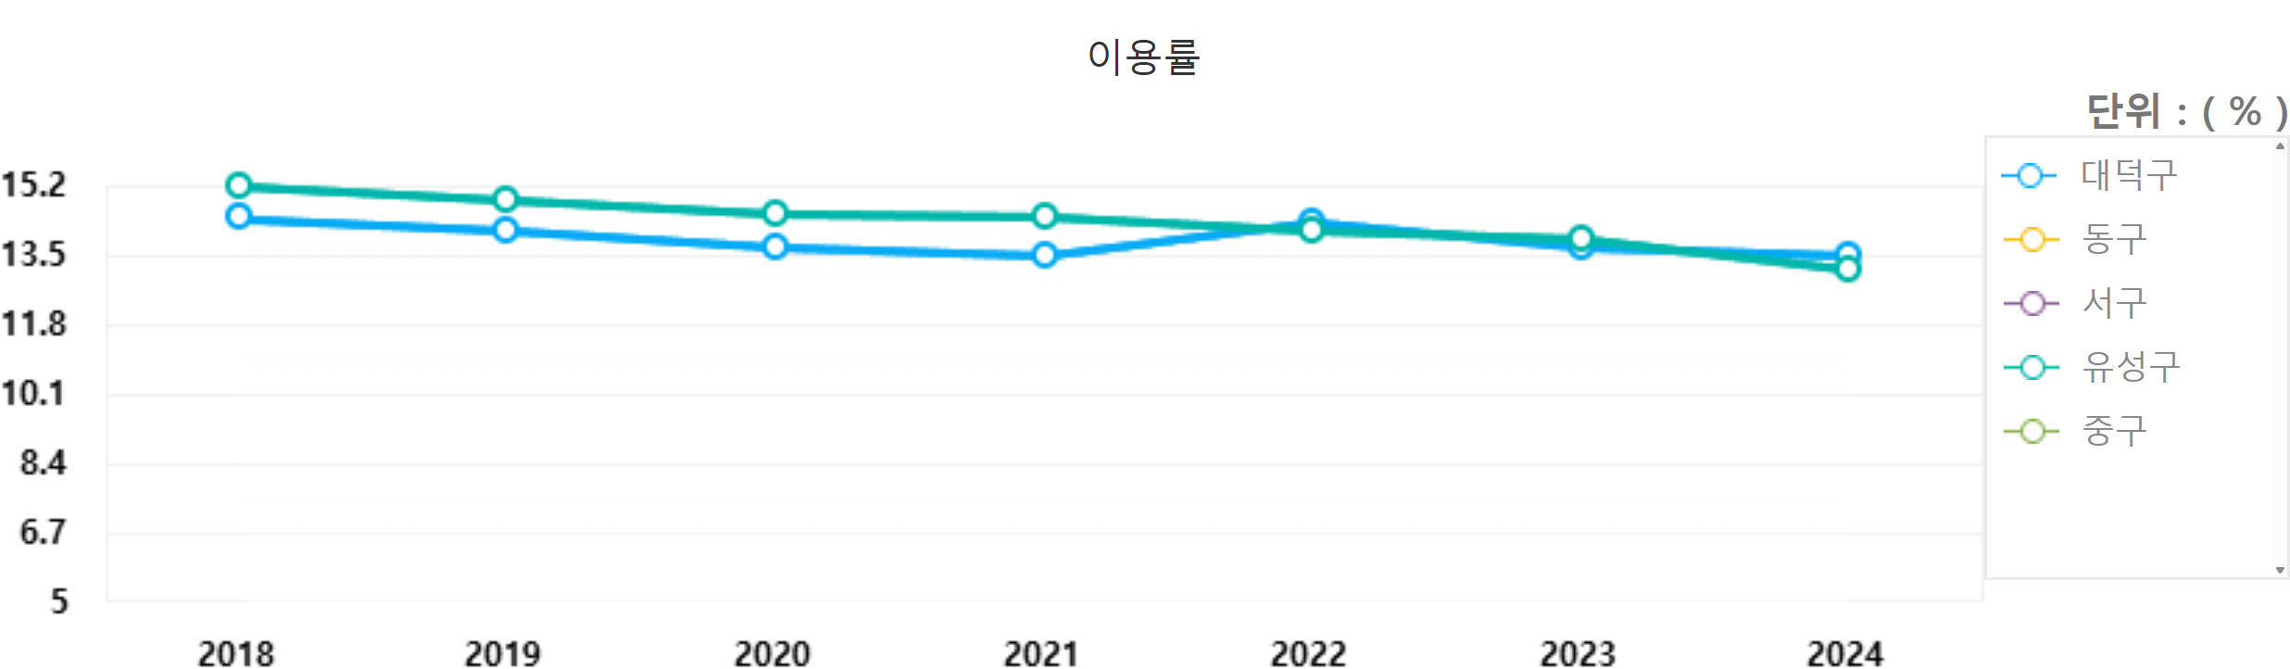
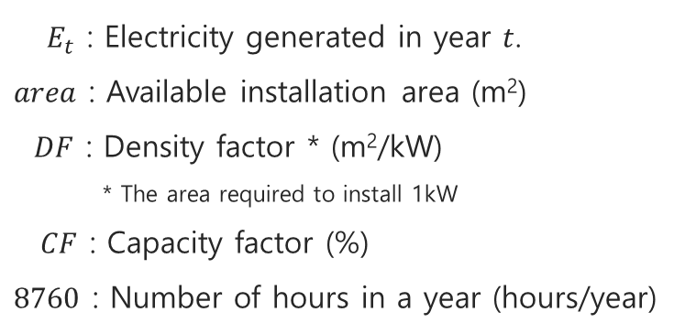

Estimation of PV generation: Capacity-based
Capacity-based Estimation
Solar panels are installed on a given land area
The total installed capacity depends on how densely the panels can be placed — that is, the density factor
The system does not operate at full capacity all the time, so we multiply by the capacity factor, and then scale it to one year (8,760 hours) to estimate annual electricity generation
$E_{t}$ = $area×{DF}^{−1}×CF×8760$
$E_{t}$ : Electricity generated in year $t$.
$area$ : Available installation area (m²)
$DF$ : Density factor * (m²/kW)
* The area required to install 1kW
$CF$ : Capacity factor (%)
$8760$ : Number of hours in a year (hours/year)
Source: https://epsis.kpx.or.kr/epsisnew/selectKnreUtilRtoChart.do?menuId=010100
국립한밭대학교 2025학년도 제1차 전임교원 공개채용 | 경제학과 자원·환경·에너지 분야 | 전 승 호

Slide 17
Teaching Demonstration: Assignment & Food for Thought

Slide 18

Assignment
You are planning to install a solar PV system on a 4,000m² plot of land located near the Department of Economics at Hanbat University. To estimate the economic feasibility of the system, you must calculate the LCOE, using two different methods of electricity generation estimation.
Discount rate: 4.5%
Installation cost: 1,366,000 KRW/kW
Operating cost: 20,500 KRW/kW/year
System lifetime: 20 years
Installation area: 4,000 m²
Solar irradiance: 4.2 kWh/m²/day
Panel-to-land area ratio (PR): 1/3
Area needed per 1kW: 10 m²/kW
Module efficiency: 20%
Capacity factor (CF): 13%
Questions
Using R or Python will earn you 2 bonus points.
Submission Method
Please submit an Excel, R, or Python file that includes the full calculation process, along with a brief interpretation (or discussion of limitations) — about half an A4 page — explaining the difference in results between the two methods, via email.
Due date : August 8th
1. Estimate the annual electricity generation (kWh/year) (5 points)
a. Using the irradiance-based method (2.5 points)
b. Using the capacity-based method (2.5 points)
2. Calculate the LCOE (KRW/kWh) for each case (5 points)
국립한밭대학교 2025학년도 제1차 전임교원 공개채용 | 경제학과 자원·환경·에너지 분야 | 전 승 호

Slide 19
Food for thought
Question 1
What are the limitations of using LCOE as the only metric to evaluate solar PV?
FOR
Question 2
How do the two generation estimation methods differ in their assumptions?
FOOD
THOUGHT
Question 3
If carbon pricing were introduced, how might that affect the competitiveness of solar PV?
Question 4
What other factors should be considered when deciding where to install solar PV systems?
국립한밭대학교 2025학년도 제1차 전임교원 공개채용 | 경제학과 자원·환경·에너지 분야 | 전 승 호

Slide 20
Research achievement

Slide 21











Outline of Research Achievement
From Data to Policy
Bridging Energy Insights with Real-World Impact
Energy Economics
Electrification and grid impact
NDC & NetZero scenario analysis
Renewable energy potential
Sector-coupling analysis
Feasibility analysis
〮 〮 〮
Data Science
Satellite-derived irradiance data
Hourly temperature data
Hourly electricity consumption data
Municipal energy balance data
Application of
Real World Policy
Human resource development
Electrification pathway
Regional climate strategy
Technology Assessment
국립한밭대학교 2025학년도 제1차 전임교원 공개채용 | 경제학과 자원·환경·에너지 분야 | 전 승 호

Slide 22

Research Across Scales
Interdisciplinary Research at the intersection of Energy, Economics and Data
Scale | Global | National | Provincial | Municipal | Local (or Grid)
Topic | Policy | Policy | Policy | Strategy | PV (Photovoltaic)
 | Developing country modeling | Corporate average fuel economy standards Energy storage system incentive tariff Electric vehicle purchase subsidy | Excise tax on bituminous coal and Subsidy on PV | Electric vehicle and power system dynamics in carbon neutral society Regional electrification paths for 2050 carbon neutrality | Spatial supply curve of PV generation Theoretical, Technical, Market potential of PV
 |  | Modeling | Modeling | Modeling | Others
 |  | Transportation modeling Estimation of avoided costs of renewable energy technologies | Energy system modeling Air pollutant modeling | Emissions decomposition Temperature-driven electricity demand estimation | TNFD (Taskforce on Nature-related Financial Disclosures) Evaluation on economic value of ecosystem
 |  | Technology | Strategy | Others
 |  | Competitiveness analysis of climate technologies Autonomous vehicle impact on energy system | Bridging national and provincial emissions reduction strategy NDC (Nationally Determined Contribution) scenario review Establishment of Gyeonggi province’s basic plan for climate change response | Energy poverty estimation
Legend
: Published article
: Research project
: Career
* Ongoing research is marked in blue.
국립한밭대학교 2025학년도 제1차 전임교원 공개채용 | 경제학과 자원·환경·에너지 분야 | 전 승 호

Slide 23
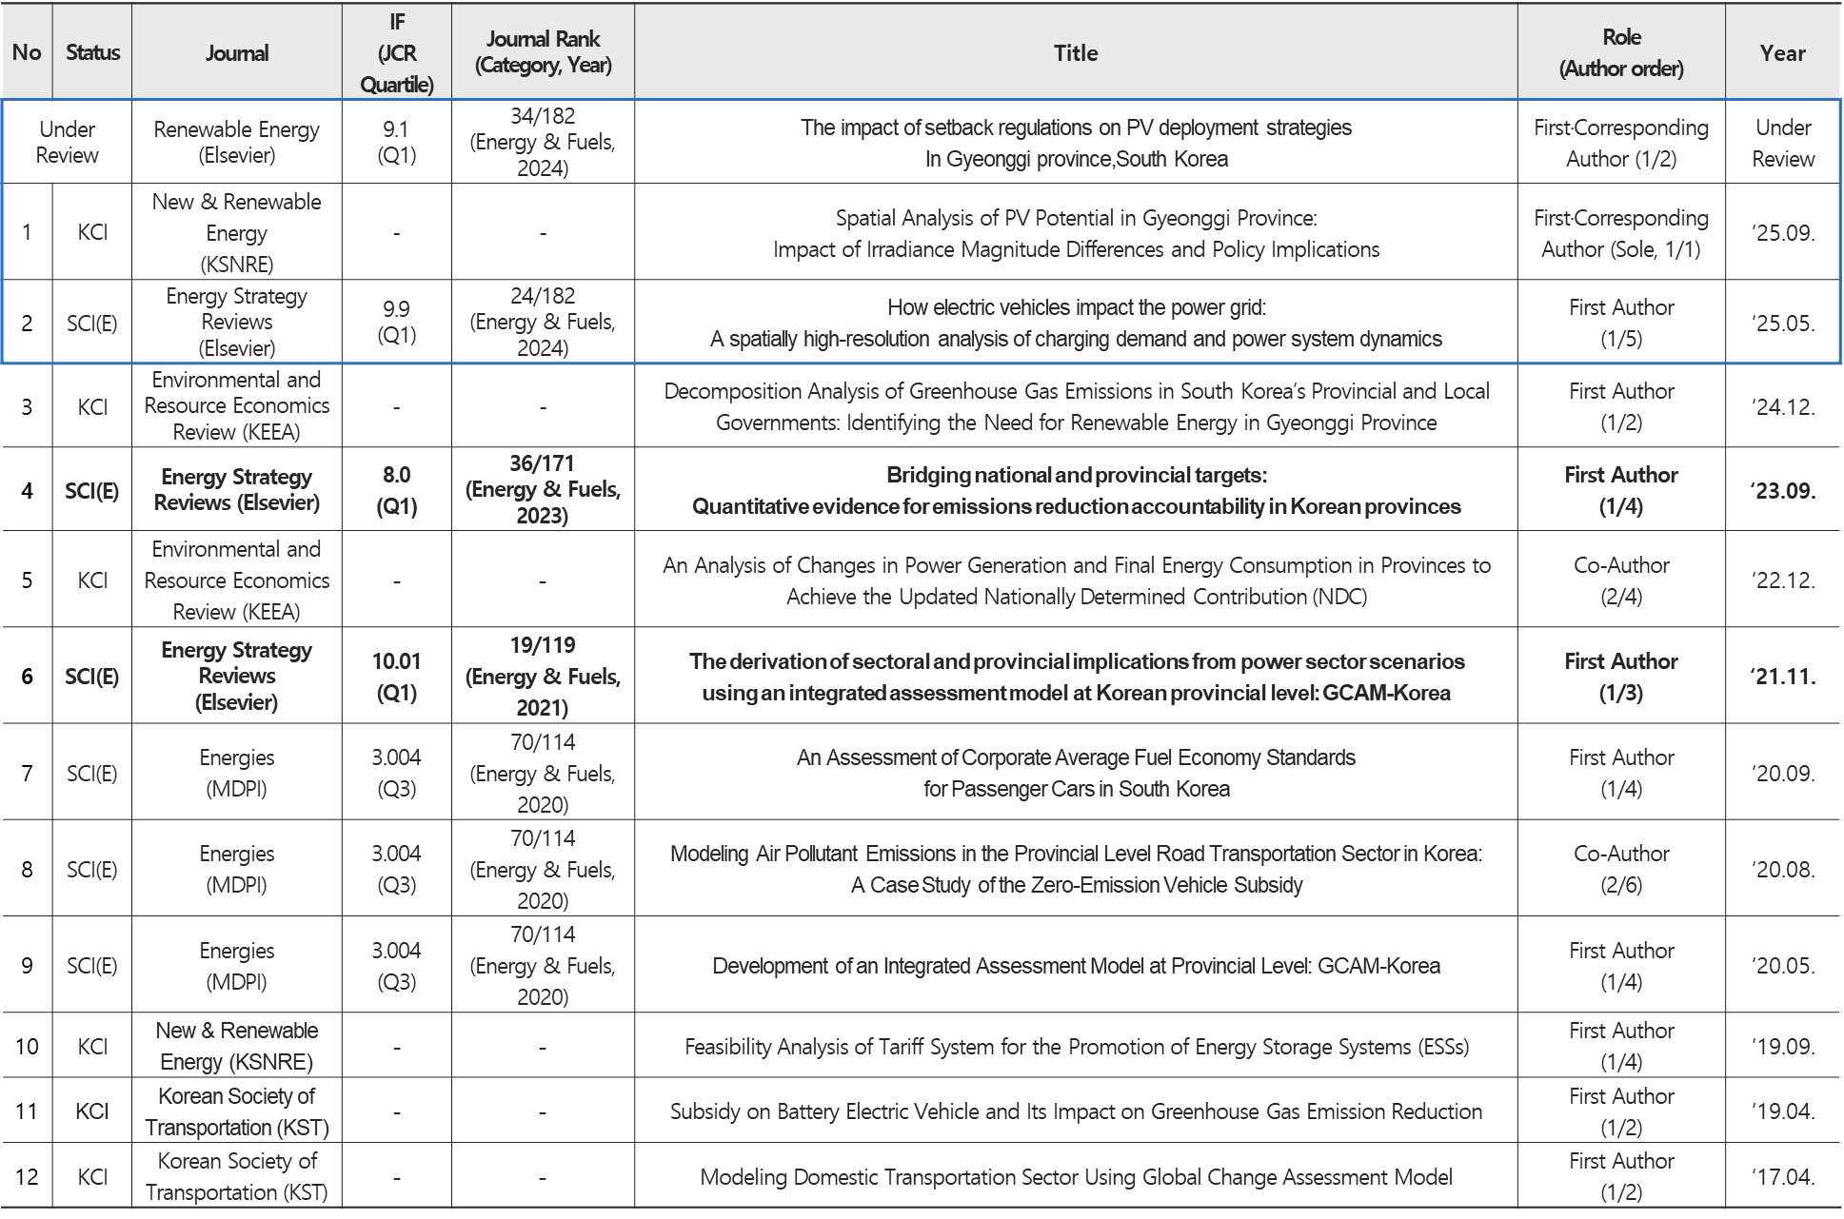
Publications
국립한밭대학교 2025학년도 제1차 전임교원 공개채용 | 경제학과 자원·환경·에너지 분야 | 전 승 호
No | Status | Journal | IF (JCR Quartile) | Journal Rank (Category, Year) | Title | Role (Author order) | Year
Under Review |  | Renewable Energy (Elsevier) | 9.1 (Q1) | 34/182 (Energy & Fuels, 2024) | The impact of setback regulations on PV deployment strategies In Gyeonggi province,South Korea | First·Corresponding Author (1/2) | Under Review
1 | KCI | New & Renewable Energy (KSNRE) | - | - | Spatial Analysis of PV Potential in Gyeonggi Province: Impact of Irradiance Magnitude Differences and Policy Implications | First·Corresponding Author (Sole, 1/1) | ‘25.09.
2 | SCI(E) | Energy Strategy Reviews (Elsevier) | 9.9 (Q1) | 24/182 (Energy & Fuels, 2024) | How electric vehicles impact the power grid: A spatially high-resolution analysis of charging demand and power system dynamics | First Author (1/5) | ‘25.05.
3 | KCI | Environmental and Resource Economics Review (KEEA) | - | - | Decomposition Analysis of Greenhouse Gas Emissions in South Korea’s Provincial and Local Governments: Identifying the Need for Renewable Energy in Gyeonggi Province | First Author (1/2) | ‘24.12.
4 | SCI(E) | Energy Strategy Reviews (Elsevier) | 8.0 (Q1) | 36/171 (Energy & Fuels, 2023) | Bridging national and provincial targets: Quantitative evidence for emissions reduction accountability in Korean provinces | First Author (1/4) | ‘23.09.
5 | KCI | Environmental and Resource Economics Review (KEEA) | - | - | An Analysis of Changes in Power Generation and Final Energy Consumption in Provinces to Achieve the Updated Nationally Determined Contribution (NDC) | Co-Author (2/4) | ‘22.12.
6 | SCI(E) | Energy Strategy Reviews (Elsevier) | 10.01 (Q1) | 19/119 (Energy & Fuels, 2021) | The derivation of sectoral and provincial implications from power sector scenarios using an integrated assessment model at Korean provincial level: GCAM-Korea | First Author (1/3) | ‘21.11.
7 | SCI(E) | Energies (MDPI) | 3.004 (Q3) | 70/114 (Energy & Fuels, 2020) | An Assessment of Corporate Average Fuel Economy Standards for Passenger Cars in South Korea | First Author (1/4) | ‘20.09.
8 | SCI(E) | Energies (MDPI) | 3.004 (Q3) | 70/114 (Energy & Fuels, 2020) | Modeling Air Pollutant Emissions in the Provincial Level Road Transportation Sector in Korea: A Case Study of the Zero-Emission Vehicle Subsidy | Co-Author (2/6) | ‘20.08.
9 | SCI(E) | Energies (MDPI) | 3.004 (Q3) | 70/114 (Energy & Fuels, 2020) | Development of an Integrated Assessment Model at Provincial Level: GCAM-Korea | First Author (1/4) | ‘20.05.
10 | KCI | New & Renewable Energy (KSNRE) | - | - | Feasibility Analysis of Tariff System for the Promotion of Energy Storage Systems (ESSs) | First Author (1/4) | ‘19.09.
11 | KCI | Korean Society of Transportation (KST) | - | - | Subsidy on Battery Electric Vehicle and Its Impact on Greenhouse Gas Emission Reduction | First Author (1/2) | ‘19.04.
12 | KCI | Korean Society of Transportation (KST) | - | - | Modeling Domestic Transportation Sector Using Global Change Assessment Model | First Author (1/2) | ‘17.04.
No | Status | Journal | IF (JCR Quartile) | Journal Rank (Category, Year) | Title | Role (Author order) | Year
Under Review |  | Renewable Energy (Elsevier) | 9.1 (Q1) | 34/182 (Energy & Fuels, 2024) | The impact of setback regulations on PV deployment strategies In Gyeonggi province,South Korea | First·Corresponding Author (1/2) | Under Review
Forthcoming |  | New & Renewable Energy (KSNRE) | - | - | Spatial Analysis of PV Potential in Gyeonggi Province: Impact of Irradiance Magnitude Differences and Policy Implications | First·Corresponding Author (Sole, 1/1)
1 | SCI(E) | Energy Strategy Reviews (Elsevier) | 9.9 (Q1) | 24/182 (Energy & Fuels, 2024) | How electric vehicles impact the power grid: A spatially high-resolution analysis of charging demand and power system dynamics | First Author (1/5) | ‘25.05.
2 | KCI | Environmental and Resource Economics Review (KEEA) | - | - | Decomposition Analysis of Greenhouse Gas Emissions in South Korea’s Provincial and Local Governments: Identifying the Need for Renewable Energy in Gyeonggi Province | First Author (1/2) | ‘24.12.
3 | SCI(E) | Energy Strategy Reviews (Elsevier) | 8.0 (Q1) | 36/171 (Energy & Fuels, 2023) | Bridging national and provincial targets: Quantitative evidence for emissions reduction accountability in Korean provinces | First Author (1/4) | ‘23.09.
4 | KCI | Environmental and Resource Economics Review (KEEA) | - | - | An Analysis of Changes in Power Generation and Final Energy Consumption in Provinces to Achieve the Updated Nationally Determined Contribution (NDC) | Co-Author (2/4) | ‘22.12.
5 | SCI(E) | Energy Strategy Reviews (Elsevier) | 10.01 (Q1) | 19/119 (Energy & Fuels, 2021) | The derivation of sectoral and provincial implications from power sector scenarios using an integrated assessment model at Korean provincial level: GCAM-Korea | First Author (1/3) | ‘21.11.
6 | SCI(E) | Energies (MDPI) | 3.004 (Q3) | 70/114 (Energy & Fuels, 2020) | An Assessment of Corporate Average Fuel Economy Standards for Passenger Cars in South Korea | First Author (1/4) | ‘20.09.
7 | SCI(E) | Energies (MDPI) | 3.004 (Q3) | 70/114 (Energy & Fuels, 2020) | Modeling Air Pollutant Emissions in the Provincial Level Road Transportation Sector in Korea: A Case Study of the Zero-Emission Vehicle Subsidy | Co-Author (2/6) | ‘20.08.
8 | SCI(E) | Energies (MDPI) | 3.004 (Q3) | 70/114 (Energy & Fuels, 2020) | Development of an Integrated Assessment Model at Provincial Level: GCAM-Korea | First Author (1/4) | ‘20.05.
9 | KCI | New & Renewable Energy (KSNRE) | - | - | Feasibility Analysis of Tariff System for the Promotion of Energy Storage Systems (ESSs) | First Author (1/4) | ‘19.09.
10 | KCI | Korean Society of Transportation (KST) | - | - | Subsidy on Battery Electric Vehicle and Its Impact on Greenhouse Gas Emission Reduction | First Author (1/2) | ‘19.04.
11 | KCI | Korean Society of Transportation (KST) | - | - | Modeling Domestic Transportation Sector Using Global Change Assessment Model | First Author (1/2) | ‘17.04.

Slide 24
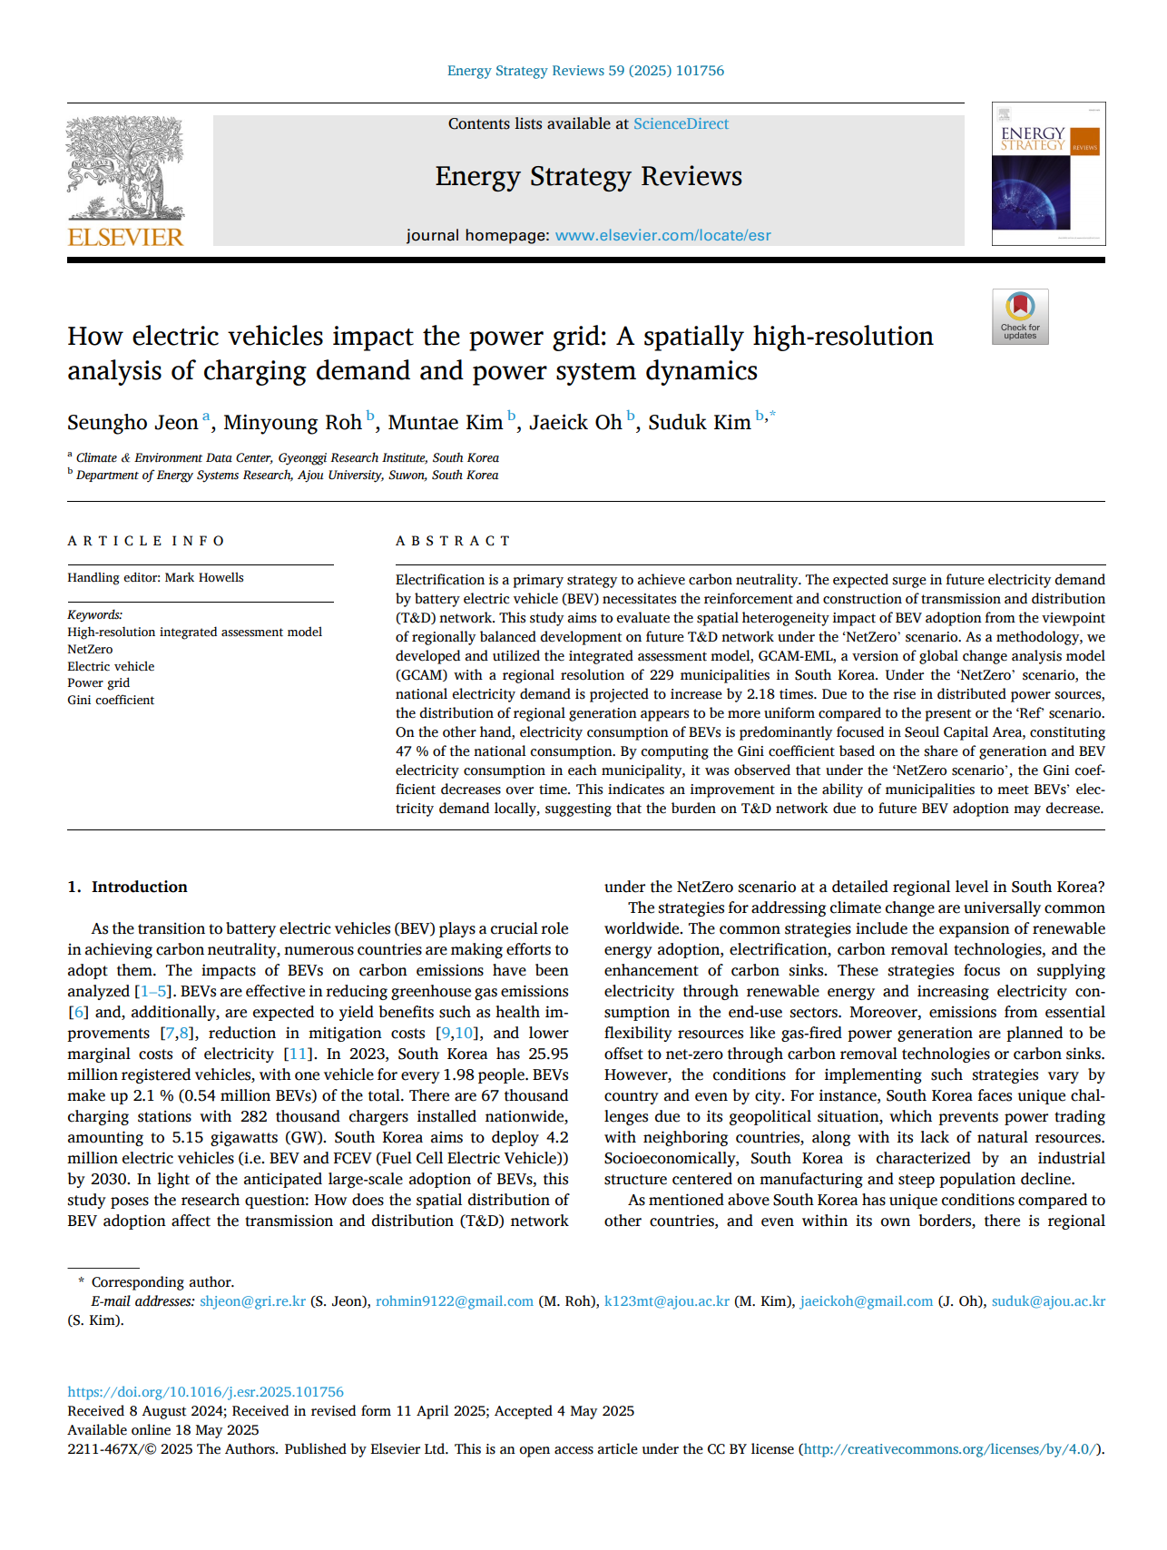
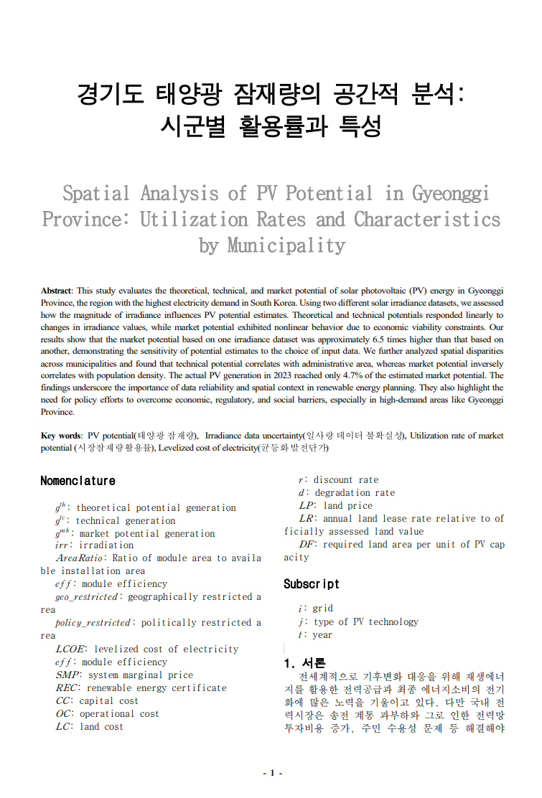
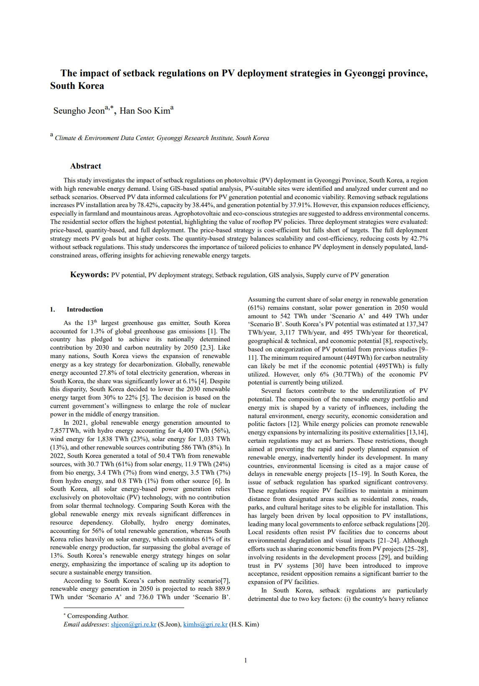
Research Progress After Faculty Application
Published
in May
Forthcoming
(Accepted with minor revision)
Under Review
국립한밭대학교 2025학년도 제1차 전임교원 공개채용 | 경제학과 자원·환경·에너지 분야 | 전 승 호

Slide 25
Research Project Participation
Bridging academic research and policy practice
★ Projects 1-3 were based on my Ph.D. dissertation: Development of GCAM-Korea (2020)
No | Funding agency |  | Period | Funding Amount (Thous. KRW) | Name
1 | ★ | Ministry of Environment, Korea Environment Corporation | ‘19.12.01. - ‘24.11.30. (60 months) | 1,750,000 | Graduate School specialized in Climate Change
2 | ★ | Korea Electric Power Corporation (KEPCO) Economy & Management Research Institute | ‘23.05.25. - ‘24.05.24. (12 months) | 105,891 | A research on regional electrification paths for 2050 carbon neutrality
3 | ★ | Gyeonggi-do | ‘21.07.19. - ‘22.04.14. (9 months) | 16,980 | Gyeonggi Province’s Basic Plan for Climate Change Response
4 | Ministry of Science and ICT, National Research Foundation of Korea |  | ‘17.09.15. - ‘21.12.31. (52 months) | 987,000 | A Research on the Impact and Competitiveness Analysis of Climate Technologies
5 | Korea Energy Agency |  | ‘18.06.22. - ‘18.12.07. (6 months) | 66,000 | Energy Demand Forecasting and Target-Setting Methodology for the Fourth Industrial Revolution
6 | Ministry of Environment |  | ‘18.09.03. - ‘18.12.14. (3 months) | 44,500 | Estimating the Avoided Costs of Renewable Energy Technologies
국립한밭대학교 2025학년도 제1차 전임교원 공개채용 | 경제학과 자원·환경·에너지 분야 | 전 승 호

Slide 26
Research achievement: Integrated Assessment Model

Slide 27
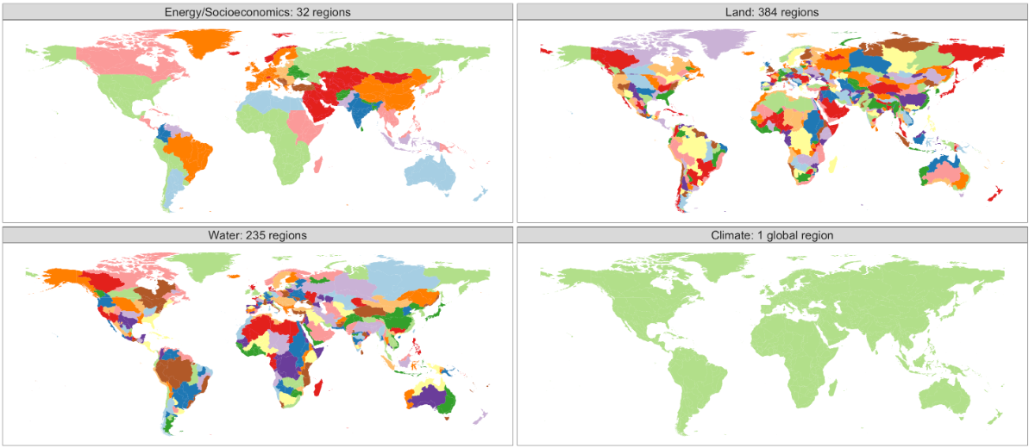
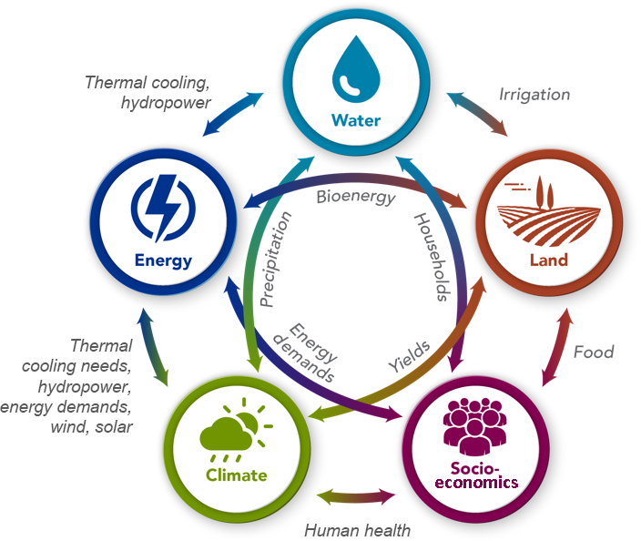
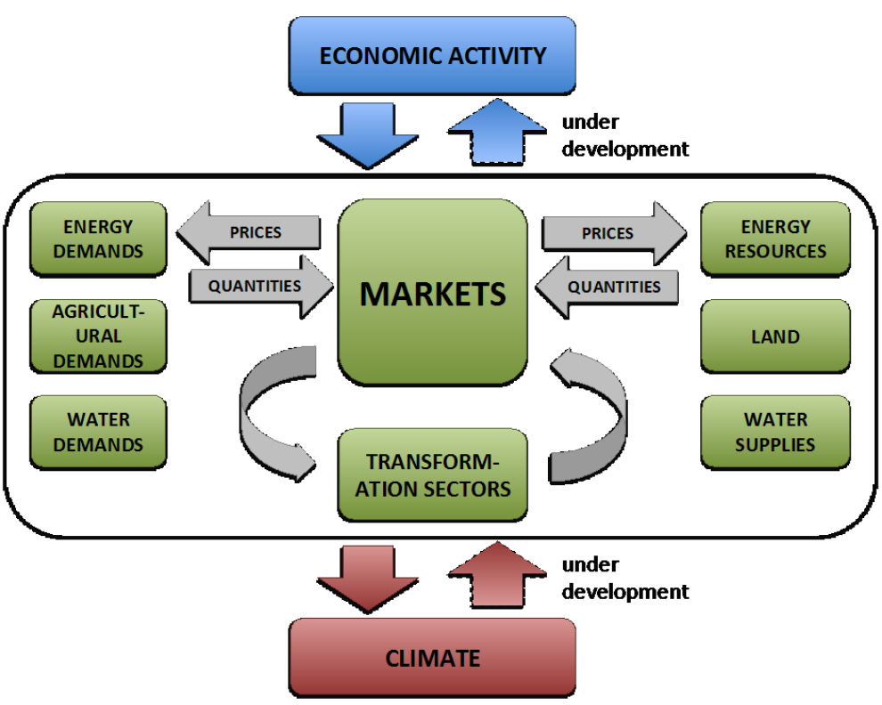
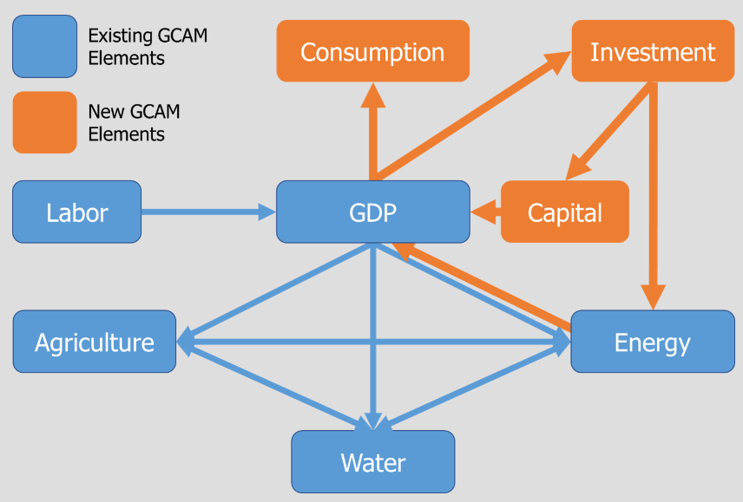
What is GCAM (Global Change Assessment Model)?
GCAM has been developed over the past 20 years at the PNNL¹⁾ in the United States
Energy Socioeconomics: 32 regions
Water basins: 235 regions
Land: 384 regions
Climate: 1 region
(IAM, Integrated assessment model) The model integrates multiple sectors including socioeconomics, energy, land-use, water, and climate systems
(Spatial resolution) It divides the world into 32 regions for socioeconomic and energy systems; South Korea is modeled as a single region
(Long-term projection) GCAM simulates in 5-year time steps from the base year 2015 to 2100
(Bottom-up model) It uses a bottom-up technology-rich structure to simulate systems at the technology level
(Equilibrium model) GCAM calculates equilibrium prices by balancing the supply and demand of resources across sectors (energy, land, water, etc.)
(Macroeconomic model) From version 7.0, GCAM incorporates GTAP²⁾ databases to construct a Social Accounting Matrix (SAM³⁾), which is then used for CGE⁴⁾-based macroeconomic interactions. This enables two-way interaction between the energy system and GDP, allowing analysis of how climate change affects macroeconomic activity
1) PNNL: Pacific Northwest National Laboratory
2) GTAP: Global Trade Analysis Project
3) SAM: Social Accounting Matrix
4) CGE: Computable General Equilibrium
Source: GCAM v.7.0 Documentation: GCAM Model Overview https://jgcri.github.io/gcam-doc/overview.html
국립한밭대학교 2025학년도 제1차 전임교원 공개채용 | 경제학과 자원·환경·에너지 분야 | 전 승 호

Slide 28



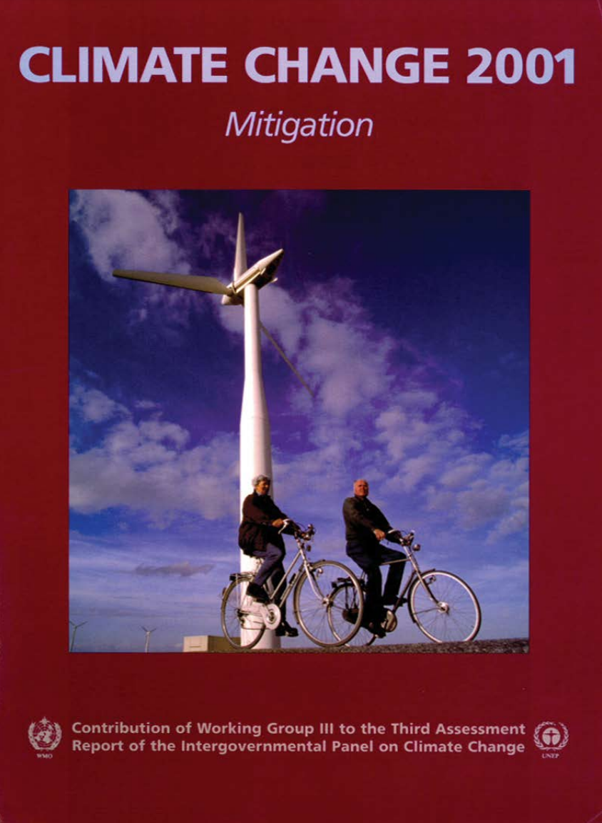

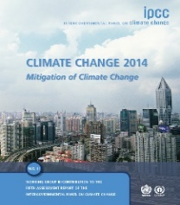
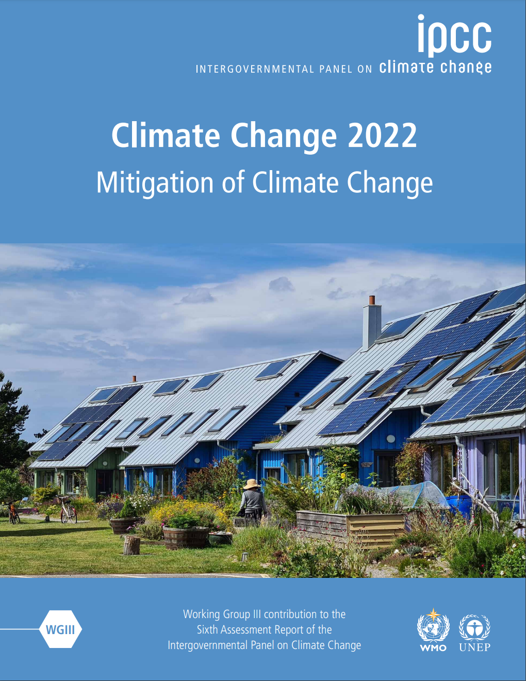


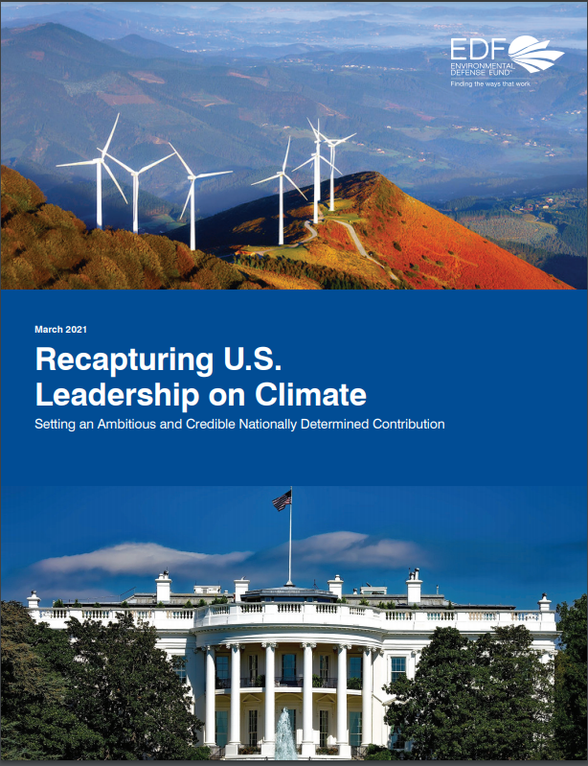
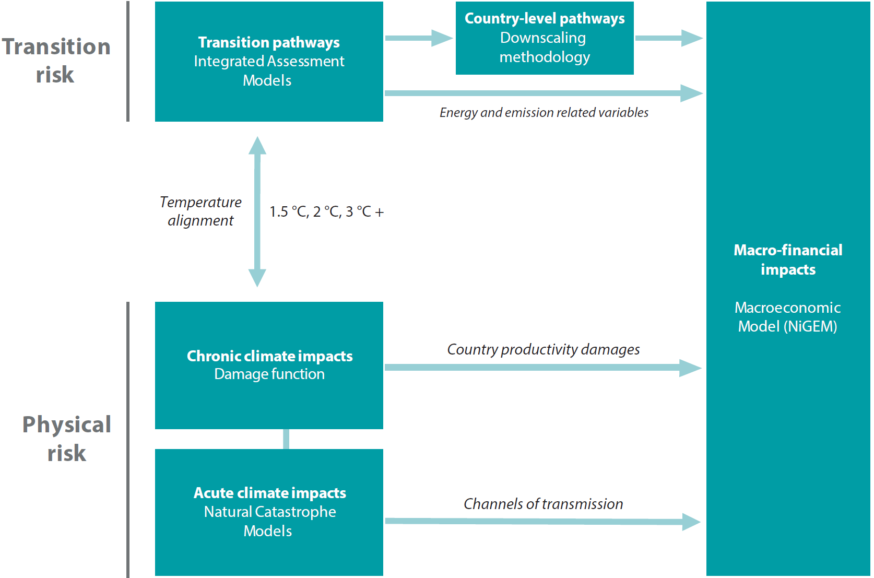

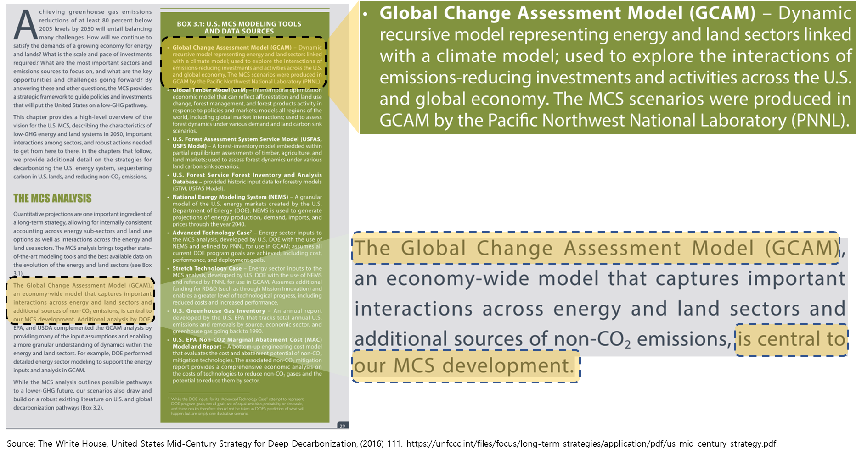
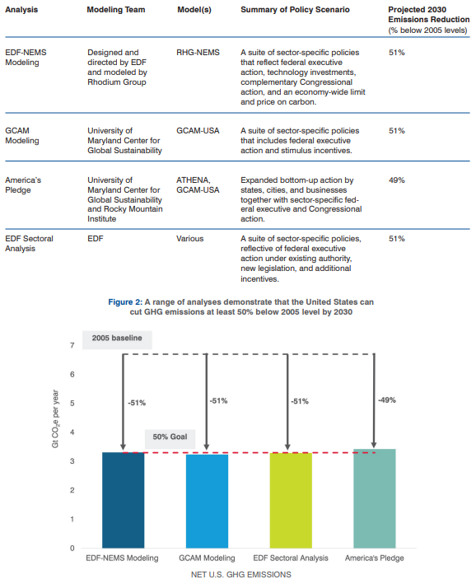
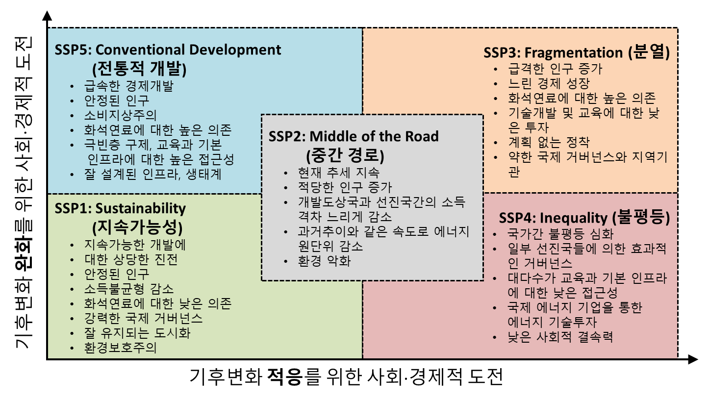
Why GCAM?
One of the main IAMs used in IPCC¹⁾ climate change scenario analyses
Used in U.S. national decarbonization strategies under the Obama administration
One of the three IAMs used in NGFS⁴⁾ transition risk analysis.
<Obama MCS²⁾ (2016)>
<EDF³⁾ Proposal (2021)>
Used by the Bank of Korea to analyze the
economic impact of climate change
<Impact of Climate Change on the Macroeconomy>
Source: IPCC, https://www.ipcc.ch/reports/
Used to develop SSP⁵⁾-RCP⁶⁾ scenarios GCAM is the marker model for SSP4
Source: NGFS, https://www.ngfs.net/ngfs-scenarios-portal/
1) IPCC: Intergovernmental Panel on Climate Change
2) MCS: Mid-Century Strategy
3) EDF: Environmental Defense Fund
4) NGFS: Network for Greening the Financial System
5) SSP: Shared Socioeconomic Pathways
6) RCP: Representative Concentration Pathways
Source: Kate Calvin. The GCAM Shared Socioeconomic Pathways(SSPs) 발표자료를 재구성.
Source: White House. https://unfccc.int/files/focus/long-term_strategies/application/pdf/mid_century_strategy_report-final_red.pdf
Source: Environmental Defense Fund (EDF). https://www.edf.org/sites/default/files/documents/Recapturing%20U.S.%20Leadership%20on%20Climate.pdf
국립한밭대학교 2025학년도 제1차 전임교원 공개채용 | 경제학과 자원·환경·에너지 분야 | 전 승 호

Slide 29
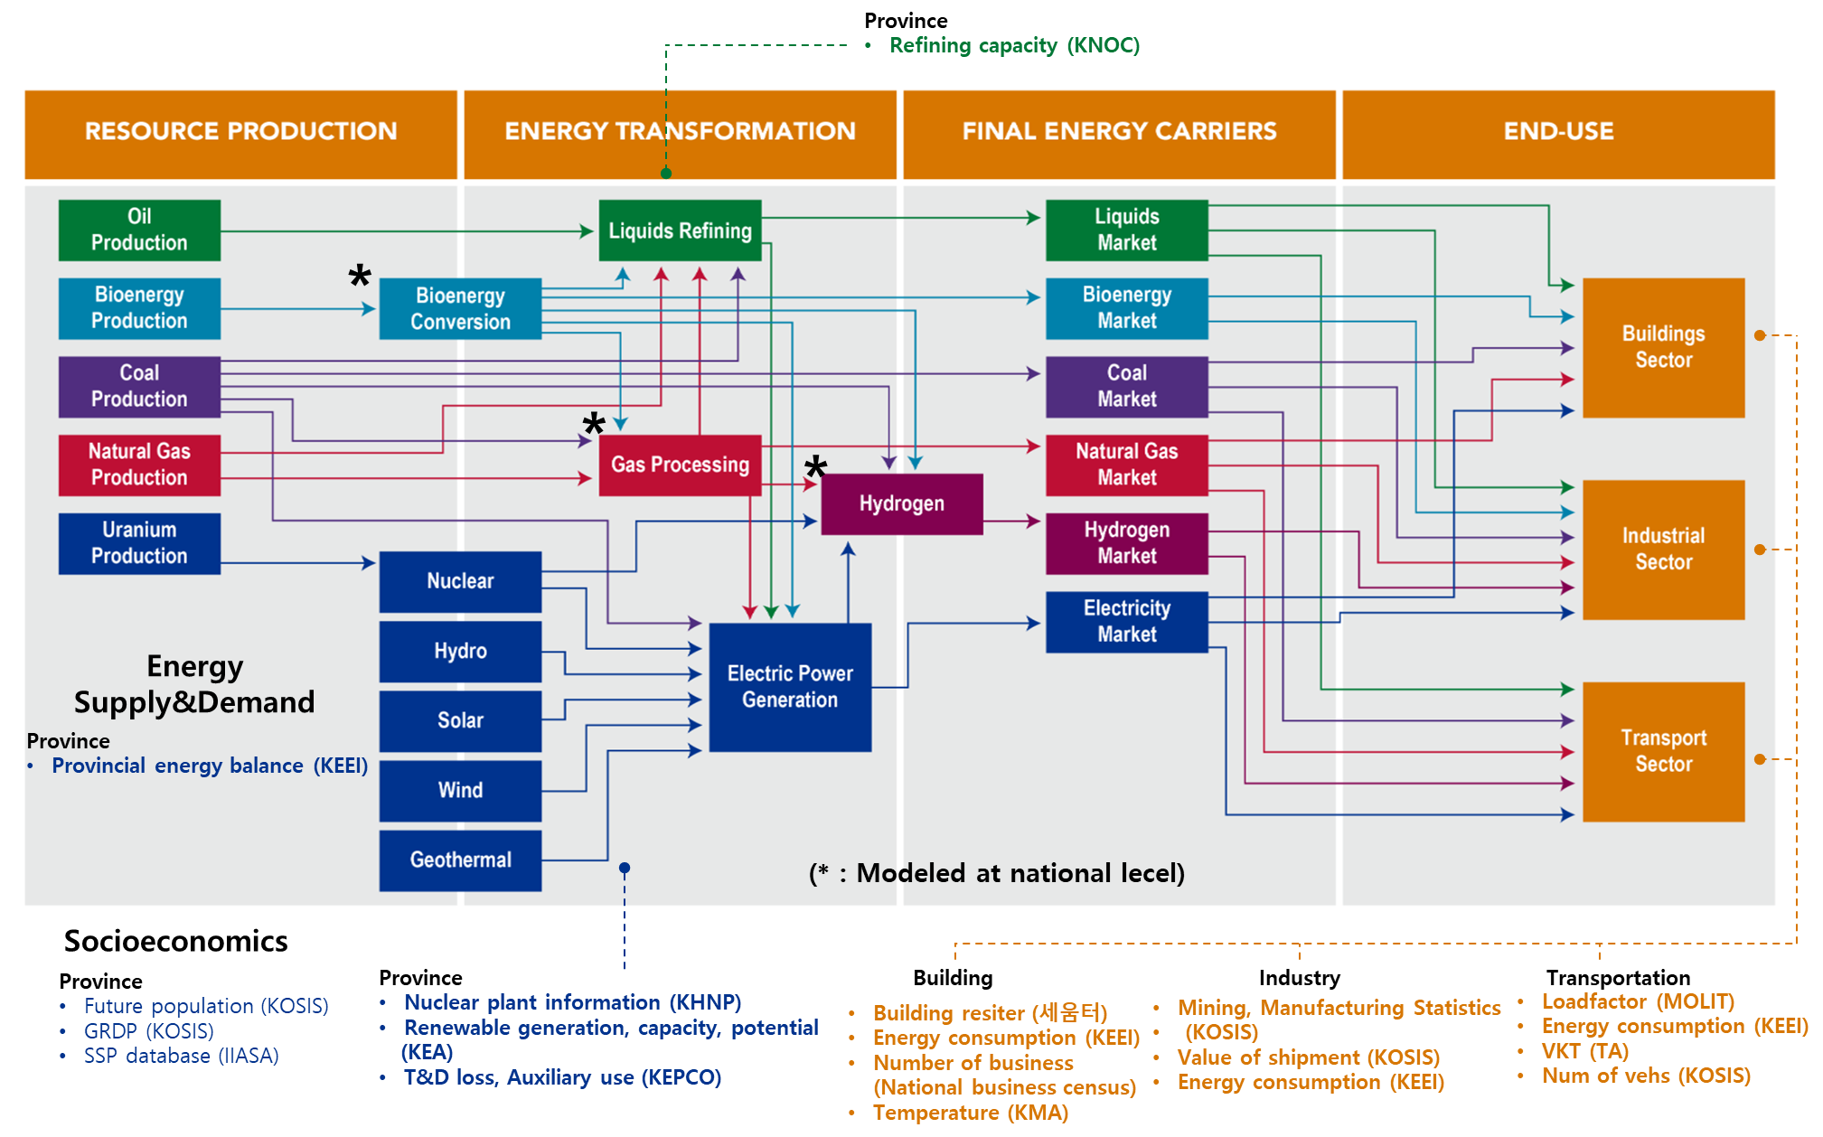
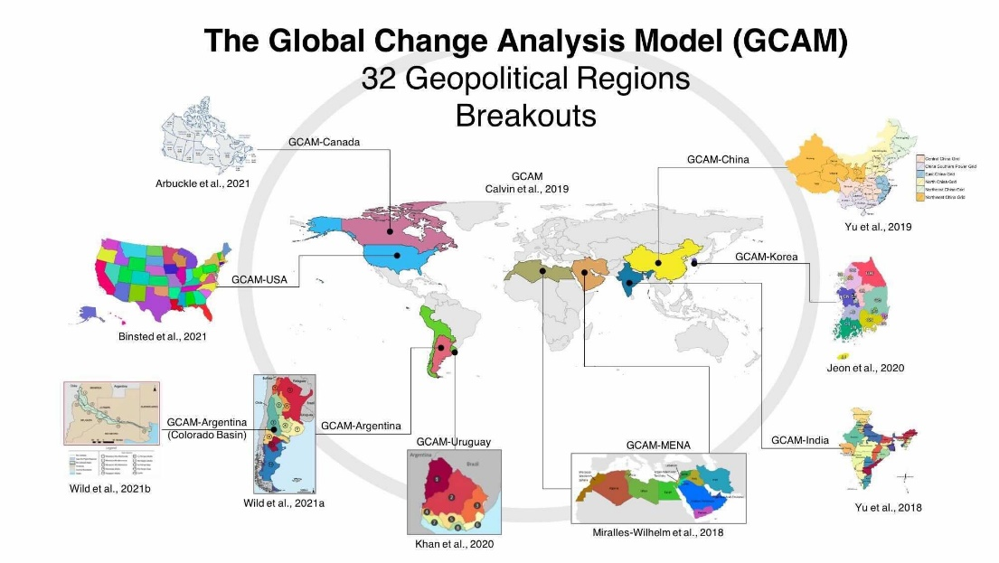
GCAM-Korea
Features of GCAM-Korea
(High resolution) Breaking down the energy system & socioeconomics of Korea into 17 provinces
(Global model) Still keeping the integrity of the global model.
(Open-source) Accessible on GitHub, enabling anyone to download it. https://github.com/EML-Ajou/GCAM-Korea
Energy systems in GCAM-Korea
South Korea
(17 provinces)
Source: JGCRI/PNNL, https://mobile.twitter.com/chris_r_vernon/status/1469435043068231688/photo/1
Source: Adapted GCAM v.7.0 Documentation - GCAM Model Overview, https://jgcri.github.io/gcam-doc/overview.html
국립한밭대학교 2025학년도 제1차 전임교원 공개채용 | 경제학과 자원·환경·에너지 분야 | 전 승 호

Slide 30
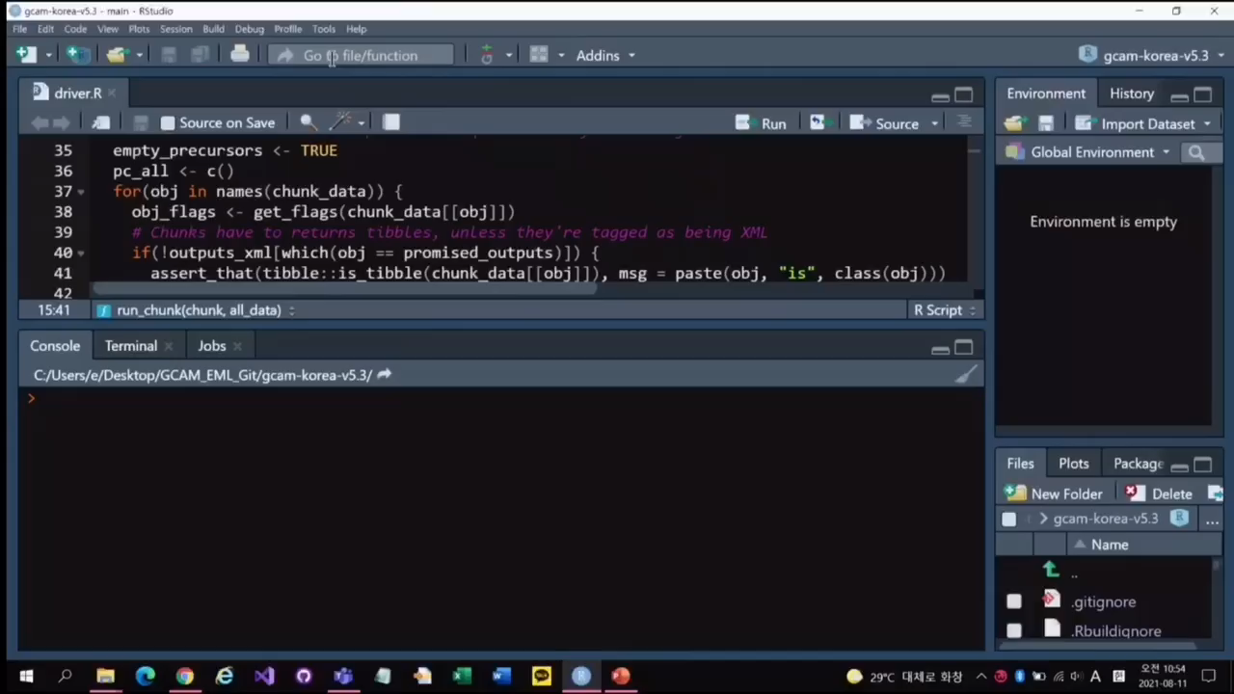
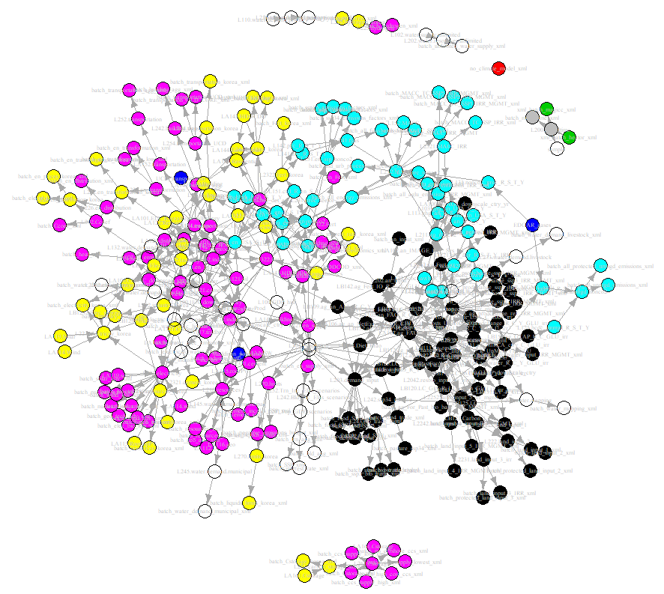



Data Science in GCAM-Korea
Data System
Through a process that entails 330 R modules, data gathered from diverse sources undergoes preprocessing and transformation into XML¹⁾ files
Part A: Input Data Generation
Energy
동영상 자료
Water
CSV
CSV
Language: R
Climate
Language: C++
Socioeconomics
Agriculture and land use
baseX
CSV
baseX
baseX
Raw Data
Over 580 CSV²⁾ files including parameters and data sourced from international organizations such as IEA³⁾, IMF⁴⁾, UN⁵⁾ and others are utilized in GCAM
Input Data
Input data(*.xml) follows a consistent set of rules and has a hierarchical structure. It is structured into around 130 XML files
Output Data
Simulation results is stored in the baseX file (or XML). The results could be extracted by using either R or Model Interface.
1) XML: eXtensible Markup Language
2) CSV : Comma Separated Values
3) IEA: International Energy Agency
4) IMF: International Monetary Fund
5) UN: United Nations
Part B: GCAM simulation
Core System
Model runs, finding international equilibrium prices that balance supply and demand in all markets
국립한밭대학교 2025학년도 제1차 전임교원 공개채용 | 경제학과 자원·환경·에너지 분야 | 전 승 호

Slide 31
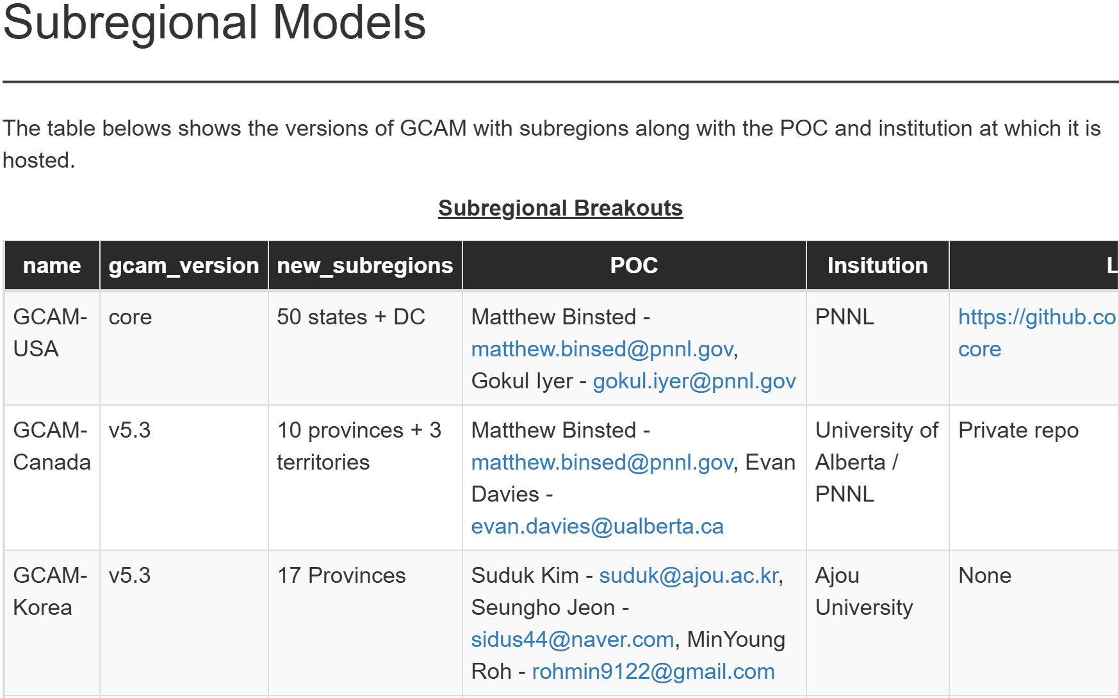
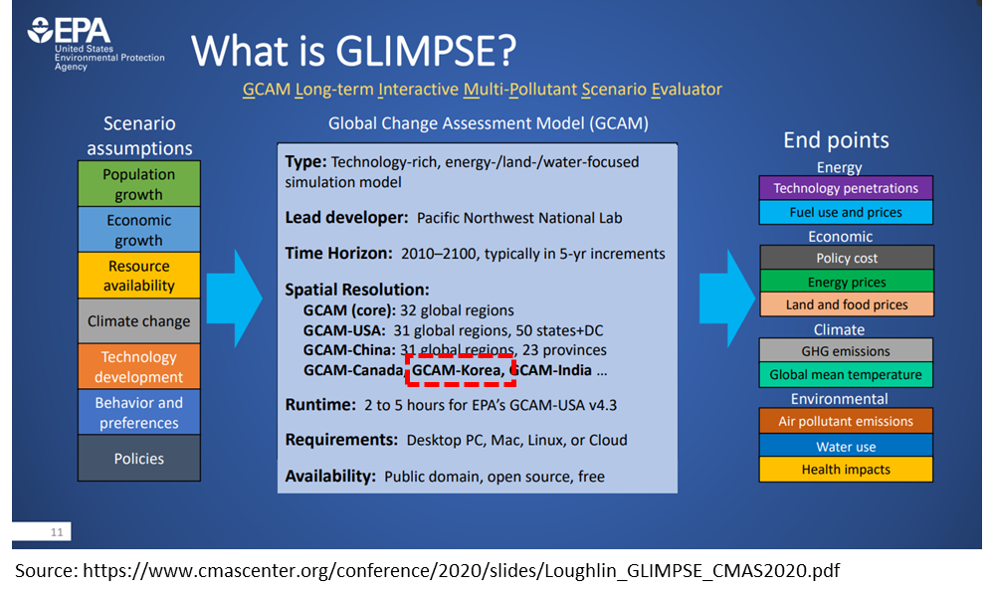
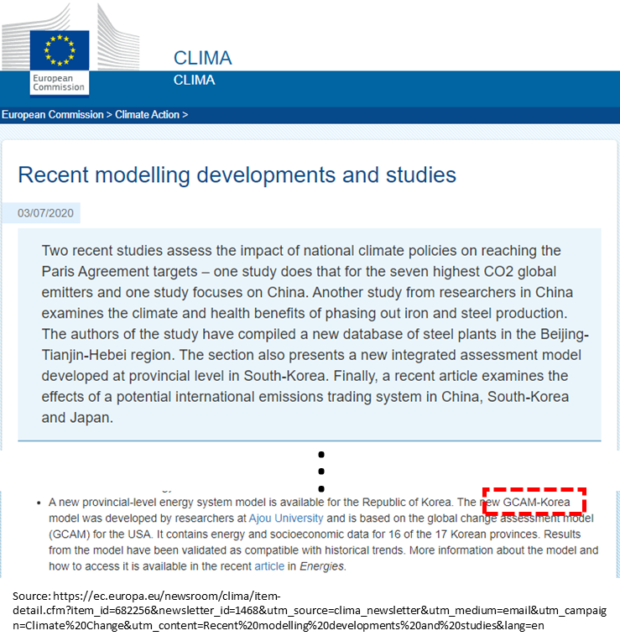
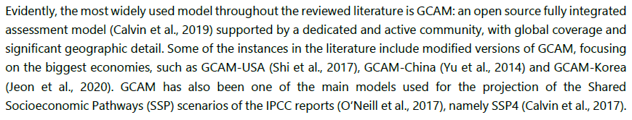
Novelty of GCAM-Korea
Official Introduction of GCAM Subregional Model
PARIS REINFORCE
U.S. Environmental Protection Agency
European Commission
Subregional GCAM Models
Source: https://jgcri.github.io/gcambreakout/articles/regional.html
Literature review of modeling
Source: https://paris-reinforce.eu/sites/default/files/2021-07/D7.3%20-%20Report%20on%20stakeholder%20needs%20and%20research%20capacity%20needed_v1.10R_REVISED.pdf
High spatial resolution model
Source: https://www.cmascenter.org/conference/2020/slides/Loughlin_GLIMPSE_CMAS2020.pdf
Literature review of modeling
Source: https://ec.europa.eu/newsroom/clima/items/682256
국립한밭대학교 2025학년도 제1차 전임교원 공개채용 | 경제학과 자원·환경·에너지 분야 | 전 승 호

Slide 32
Power grid implications of electrification (2025)
Research Question How does electric vehicle (EV) adoption affect the national grid?
Background |  | Spatial mismatch between power supply and demand Expansion of EVs raises concerns over insufficient transmission infrastructure
Scenario |  | (Reference) No mitigation policies are implemented (business as usual) (NetZero) Mitigation policies in place to achieve net-zero emissions by 2050
Main findings |  | Spatial mismatch is reduced as supply becomes more balanced
 | Power Supply |  |  | Power Demand
 | Retirement of coal-fired power plants Nationwide expansion of solar PV Power supply becomes spatially balanced |  |  | Population is assumed to remain concentrated in the capital region EV adoption is concentrated in the capital region. Power demand from EVs remains spatially concentrated.
Implications |  | Spatial coordination of power supply-demand Electrification does not necessarily worsen grid stress if supply becomes spatially distributed.
국립한밭대학교 2025학년도 제1차 전임교원 공개채용 | 경제학과 자원·환경·에너지 분야 | 전 승 호

Slide 33
Research achievement: Empirical and Applied Research

Slide 34
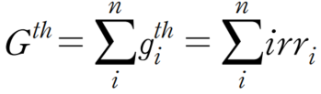
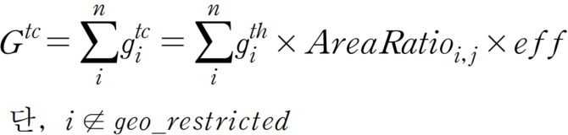
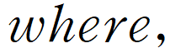
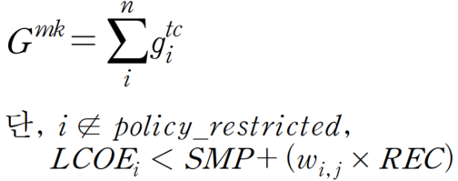
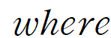
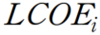
Spatial Analysis of solar PV (Jeon, 2025)
Research Question How much solar PV potential is economically usable and utilized?
Background | Gyeonggi-do has the highest electricity demand but a relatively low level of renewable generation
Method | GIS (Geographic Information System) spatial analysis based on satellite imagery irradiance data (1.5km raster) Three-tier PV potential assessment (Theoretical > Technical > Market potential) Economic viability based on LCOE vs. SMP (System Marginal Price)+REC (Renewable Energy Certificate) threshold using land prices at grid-level Municipality-level utilization rates assessed (Actual generation ÷ market potential)
Main findings | Large spatial disparities in utilization rates Gwangju : 147.1%, Paju : 2.2%
Implications | Policy attention is needed for underutilized but high-potential areas (e.g. Yeonchoen)
<Theoretical potential>
<Technical potential>
<Market potential>
: theoretical potential in Gyeonggi-do (MWh)
: theoretical potential of each grid cell ( ) (MWh)
: irradiance (MWh/year/100m²)
: technical potential in Gyeonggi (MWh)
: technical potential of each grid cell ( ) (MWh)
: panel coverage ratio (%)
: module efficiency (%)
: geographically restricted area
: politically restricted area
: levelized cost of electricity of each grid cell ( ) (MWh)
: system marginal price (won/kWh)
: renewable energy certificate (won/kWh)
: REC weight (unitless)
국립한밭대학교 2025학년도 제1차 전임교원 공개채용 | 경제학과 자원·환경·에너지 분야 | 전 승 호

Slide 35
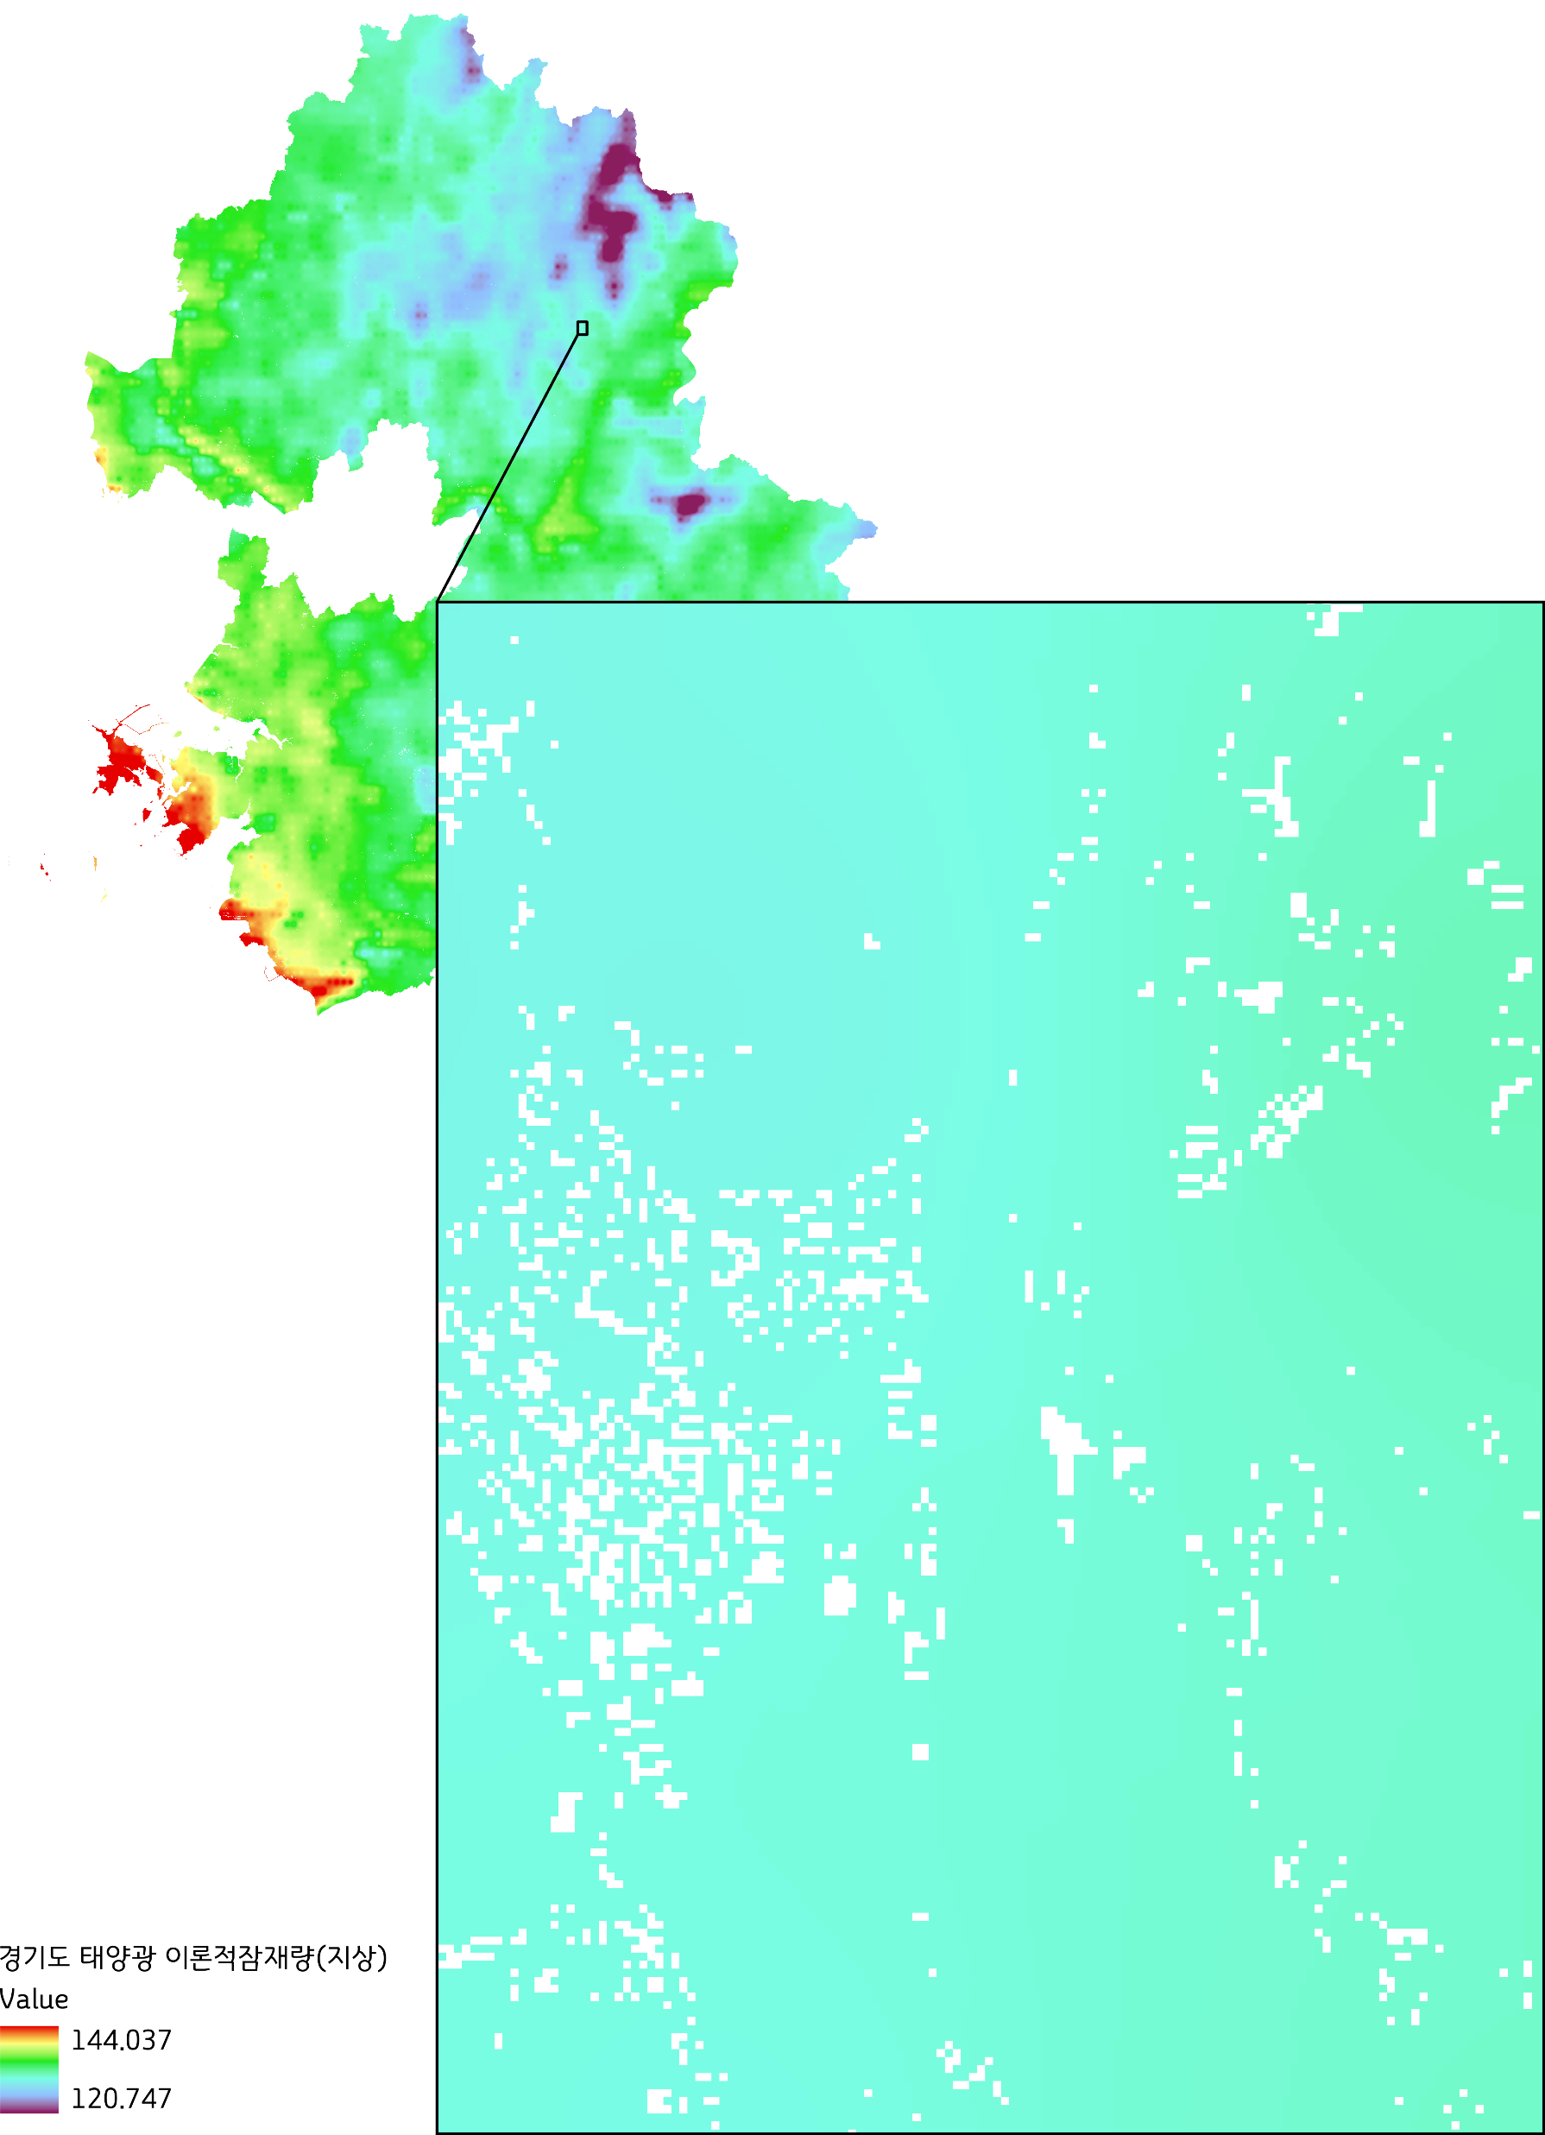
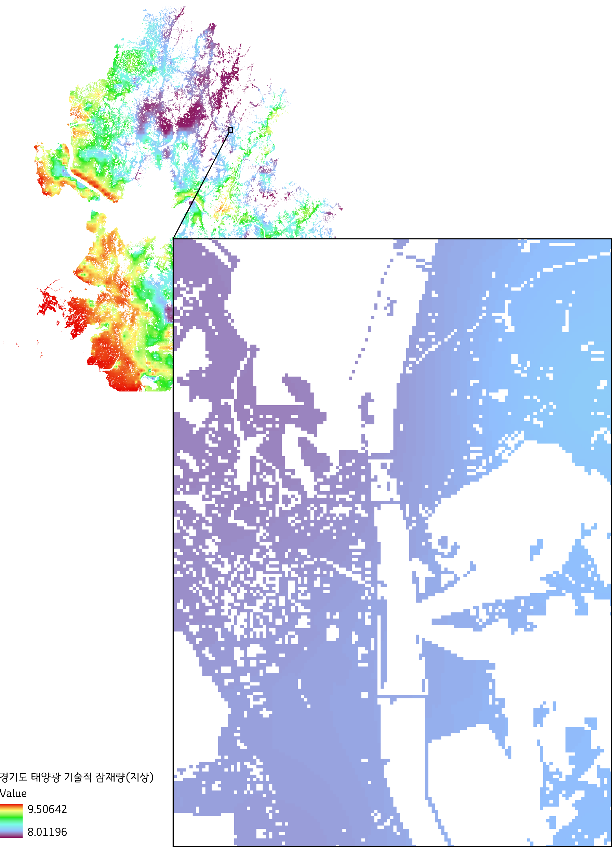
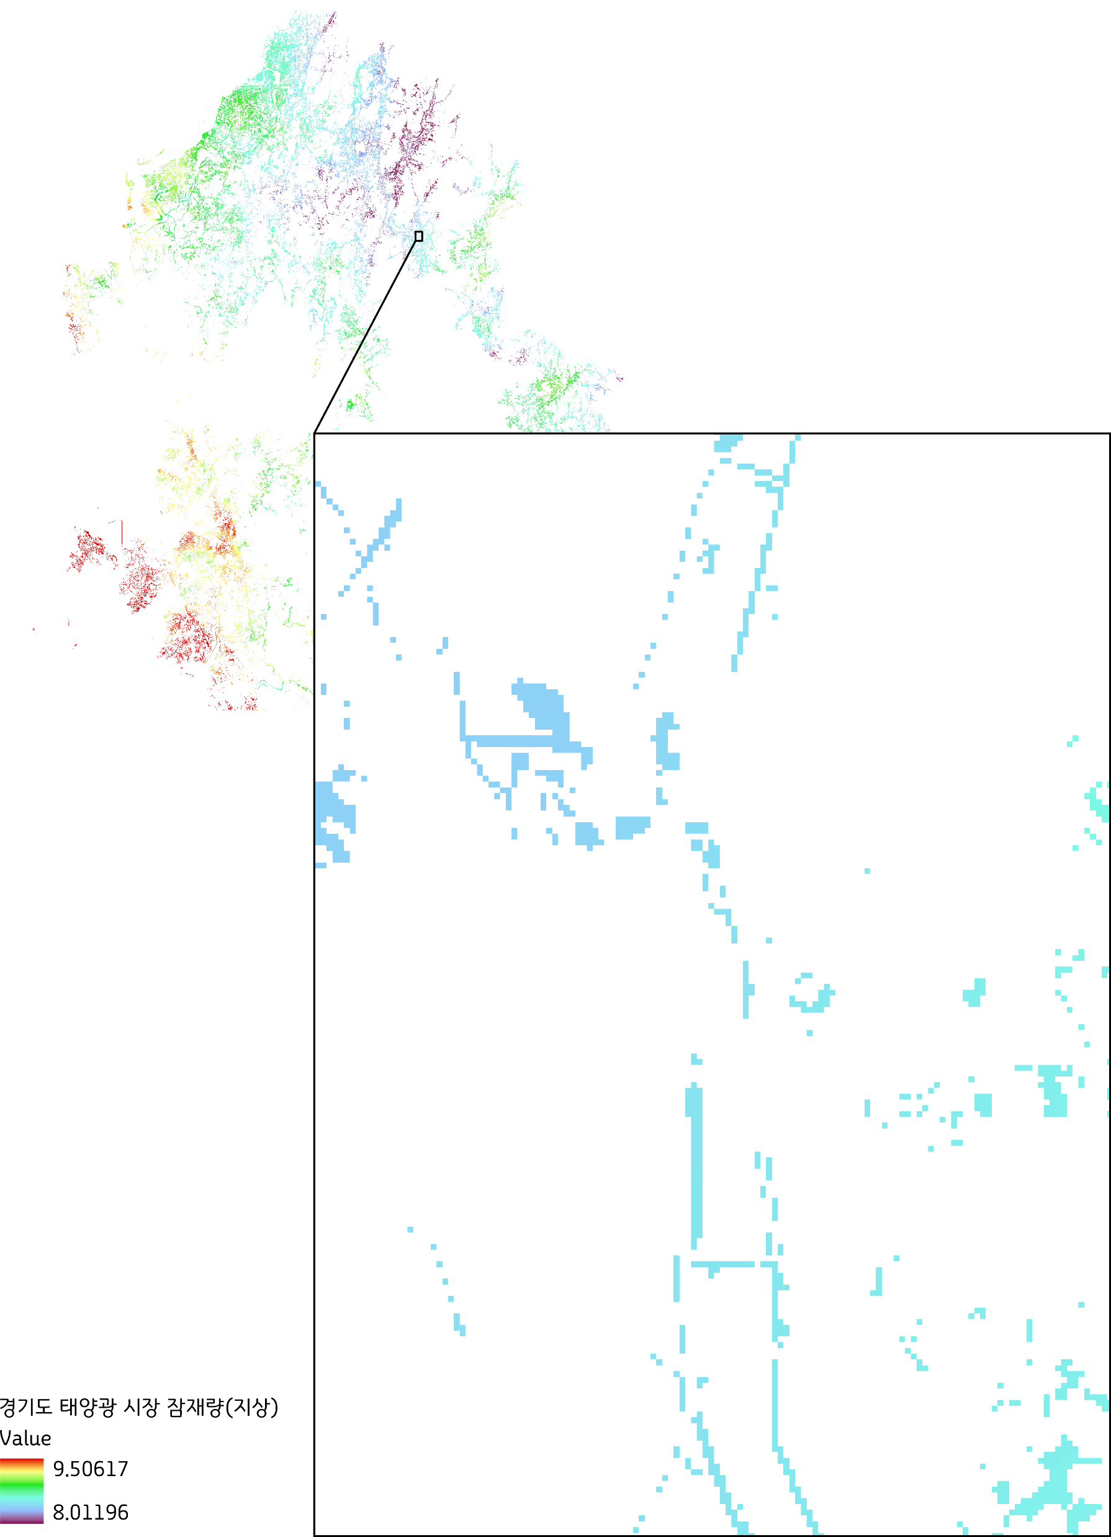
Spatial Analysis of solar PV (Jeon, 2025)- Solar PV potential in Gyeonggi
Theoretical potential
Technical potential
Market potential
(MWh/year/m²)
(MWh/year/m²)
(MWh/year/m²)
Source: Author
Source: Author
Source: Author
국립한밭대학교 2025학년도 제1차 전임교원 공개채용 | 경제학과 자원·환경·에너지 분야 | 전 승 호

Slide 36
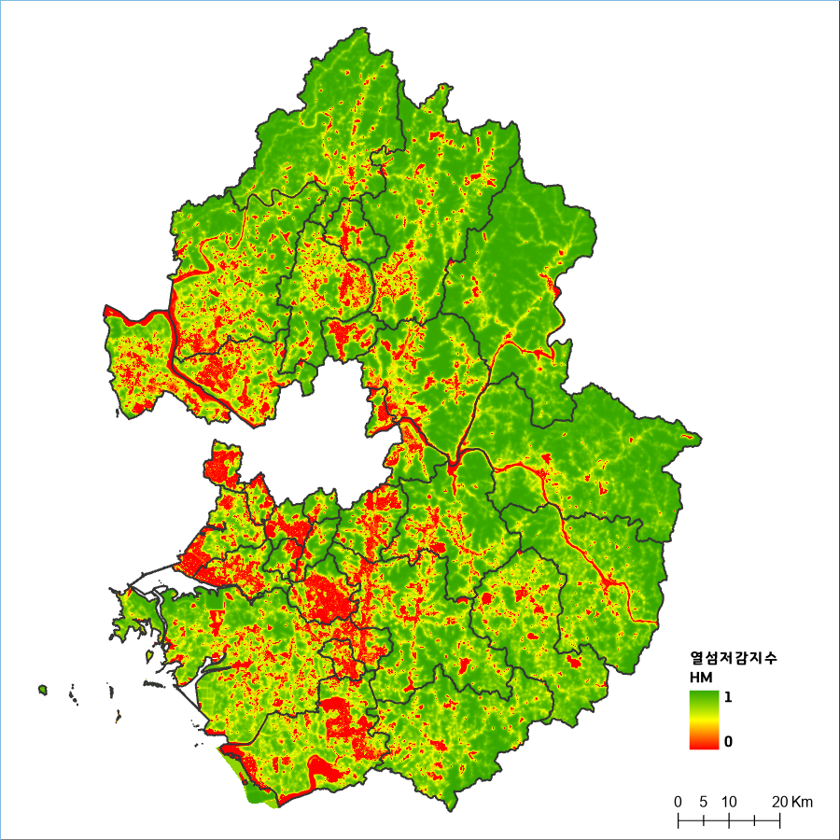
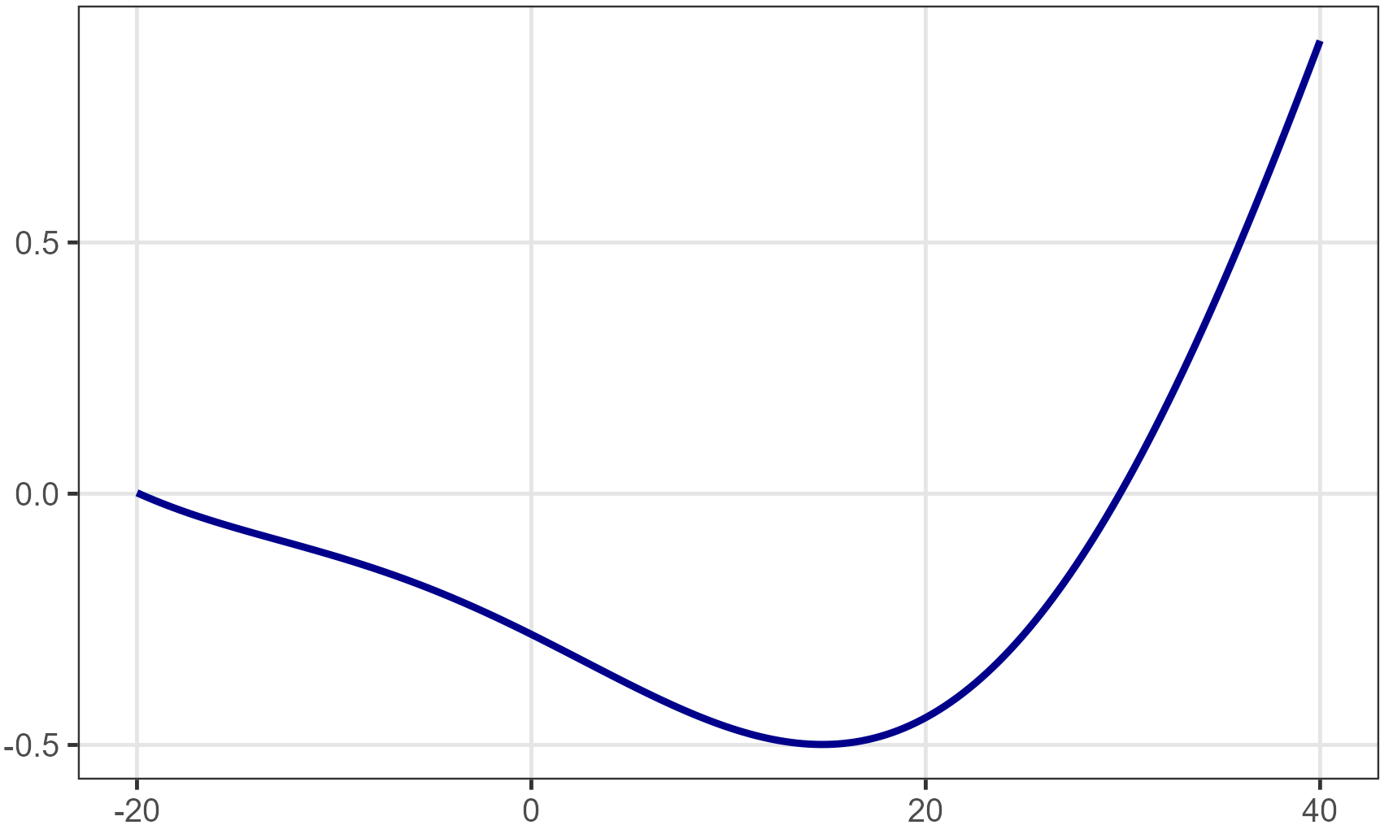
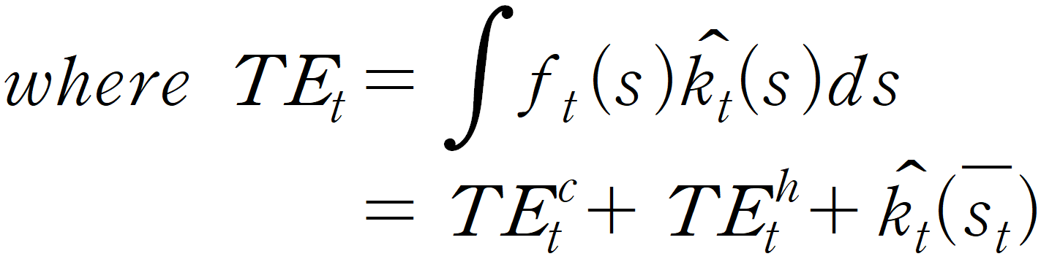
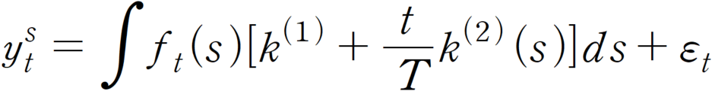
Bridging environment and energy
Research Question
How much electricity can we save by greening our cities?
Green space↑
Heat ↓
Electricity use for cooling ↓
Research Design
(Background) An extended study on the monetary valuation of ecosystem regulating services
(Objective) To estimate the cooling effect of green space and the resulting change in electricity demand for cooling under temperature variation
(Data)
Hourly temperature data (2004-2024, 77 stations nationwide) from ASOS¹⁾ provided by KMA²⁾ retrieved via API³⁾
Monthly electricity consumption by cities and contract type provided by KEPCO⁴⁾
Heat Mitigation impact
using InVEST* model
Temperature response function (TRF)
Electricity demand function
Heat Mitigation
index
City: Suwon,
Tariff: General service
Monthly electricity sales
Monthly effective days
Real electricity tariff index
Monthly GRDP
Monthly temperature effect
TRF
Source: Author
temperature (℃)
ASOS: Automated Synoptic Observing System
KMA: Korea Meteorological administration
API: Application Programming Interface
KEPCO: Korea Electric Power Corporation
Source: Gyeonggi research institute and National Institute of ecology
* InVEST model: Integrated Valuation of Ecosystem Services and Tradeoffs
국립한밭대학교 2025학년도 제1차 전임교원 공개채용 | 경제학과 자원·환경·에너지 분야 | 전 승 호

Slide 37
Teaching Experience & Plan

Slide 38
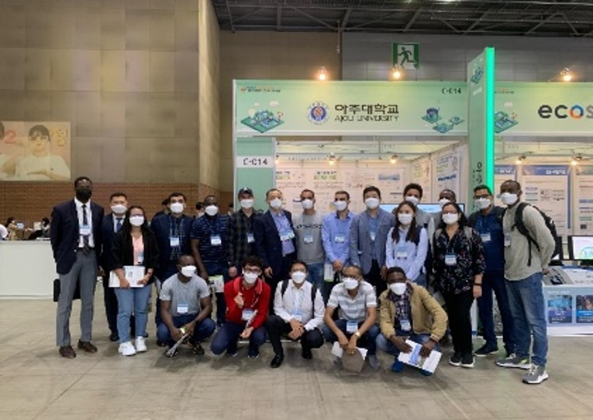






Teaching Experience
▷ Affiliation | Graduate School of International Studies, Ajou University
▷ Program Title | KOICA-AJOU Master’s Degree Program in Energy Science and Policy
▷ Role | Lecturer and thesis mentor Energy and Climate Modeling I*, II Energy System in Modern Society Selected Topics in Energy & Environment Studies
▷ Target Students | Government officials from developing countries in the fields of energy and environment
2021 대한민국 에너지대전 부스운영
: KOICA 학생들 초대 (Oct.14th)
Source: Author
< Master’s Theses under my mentorship>
* Thesis qualification is granted only to those who achieve a B+ or above in this course.
국립한밭대학교 2025학년도 제1차 전임교원 공개채용 | 경제학과 자원·환경·에너지 분야 | 전 승 호

Slide 39
Teaching Experience
Energy and Climate Modeling I
Energy and Climate Modeling II
Energy System in Modern Society
Selected Topics in Energy & Environ. Studies
▷ Lecture: 50% / Practice: 50%
▷ Class Format
Lectures on energy systems structure
Step-by-Step R programming exercises
Hands-on analysis of GCAM*
▷ Class Content
Energy balance overview and interpretation
Introduction to R: data processing and visualization
Scenario analysis
Midterm and final project
▷ Lecture: 50% / Practice: 50%
▷ Class Format
Thematic lectures on energy sectors and policies
Step-by-Step R programming exercises
Hands-on analysis of GCAM
▷ Class Content
Sectoral modules in GCAM
GCAM data system: structure and management
SSP, RCP scenario analysis and NDC** discussions
Midterm and final project
▷ Lecture: 100%
▷ Class Format
Instructor-led overview of each reading
Student presentations on assigned materials
Guided discussion and feedback
▷ Class Content
Comparative analysis of national strategies
Coal phase-out & Fossil fuel transition
Sector-specific decarbonization
Global cooperation and policy coordination
▷ Lecture: 20% / Practice: 80%
▷ Class Format
Hands-on policy modeling based on real-world studies
Instructor-led code walkthrough and R practice
Country-specific analysis using provided data templates
▷ Class Content
Replicated the retirement algorithm of coal power plant from Cui et al. (2021, Nature Communications) using R
Applied multi-criteria scoring
Customized analysis for student-selected countries
* GCAM: Global Change Assessment Model ** NDC: Nationally Determined Contributions
국립한밭대학교 2025학년도 제1차 전임교원 공개채용 | 경제학과 자원·환경·에너지 분야 | 전 승 호

Slide 40



Teaching Philosophy
Understanding Systems
Introduction of Energy Systems
Energy flow
Energy balance
Introduction of Renewable Energy
Renewable energy source
Intermittency of renewable energy
Overview of Curriculum
Interdisciplinary
energy economists
with system thinking,
analytical ability, and policy insight
Data Practice
Energy Data Practice I
Basics of R & Python
Visualization
Energy Data Practice II
Regression
Simulation
Connect
theory & data
to understand complex systems in energy economics
“Graphs are
the language
of data”
- Steven E. Koonin -
Real world application
Energy Modeling
Estimation of energy demand
Visualization
Individual Career Exploration
Undergraduate Thesis
Advanced Data Analytics Professional
국립한밭대학교 2025학년도 제1차 전임교원 공개채용 | 경제학과 자원·환경·에너지 분야 | 전 승 호

Slide 41










Student Mentoring to Nurture Glocal Leader
Encourage students to write undergraduate thesis on energy-related topics
Support participation in student paper competition (Korean Resource Economics Association)
Promote journal publication to enhance students’ competitiveness
Thesis
Supervision
Motivate students to obtain certifications based on course content
(e.g. ADAP, Advanced Data Analytics Professional)
Operate a student club to support certification preparation
Obtaining
Certification
Offer individualized guidance such as reading discussion and career mentoring
Provide tailored support for students preparing research proposals, competition, certifications
Personalized
Institution
Engagement in Global Conferences
International Field Study Opportunities
Global University Partnerships
Global
Networking
Guide students to explore internship opportunities at public institutions such as GIR (Greenhouse Gas Inventory & Research Center)
Provide guidance for master’s graduates seeking employment at regional policy research institutes such as GRI (Gyeonggi Research Institute)
Internship &
Job Opportunity
국립한밭대학교 2025학년도 제1차 전임교원 공개채용 | 경제학과 자원·환경·에너지 분야 | 전 승 호

Slide 42






Contribution Plan
Fostering Interdisciplinary Talent
to Support Regional and National Development
Convergence
Research Center
Promoting transdisciplinary research across science,
technology, and the humanities
and social sciences
Source: Author
Graduate School Specialized in Climate Change
Graduate programs to train experts and conduct foundational research for national climate policy and
international climate commitments
Leading Research Center
(May 2022) Ajou University,
Applied for the CRC program
Human
Resource
Development
Program
Regional
Society
Development
Community-Based
Research Engagement
Contributing to the community through partnerships with local research institutes
(2019-2024) Ajou University,
Experience as an administrative coordinator
국립한밭대학교 2025학년도 제1차 전임교원 공개채용 | 경제학과 자원·환경·에너지 분야 | 전 승 호
Notes:
다학제적 융합인재 양성을 통한 지역사회 발전

Slide 43
Thank you

